Slide 1


MONETARY
AUSTERITY,
INFLATION &
INEQUALITY
LOUIS-PHILIPPE ROCHON
Laurentian University, Canada
Editor-in-Chief, Review of Political Economy
Founding Editor, Review of Keynesian Economics
Wednesday, February 22, 2023 @ 1 PM
UNITED NATIONS
Room UN Secretariat, S-1523 FC
New York

Slide 2
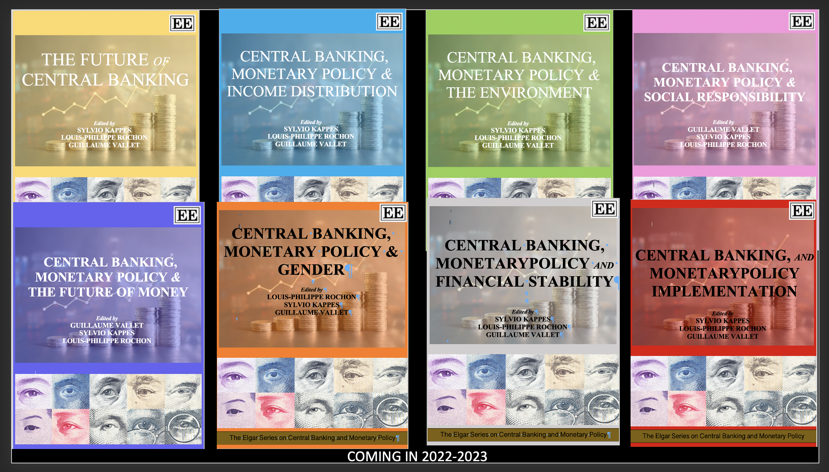

Slide 3
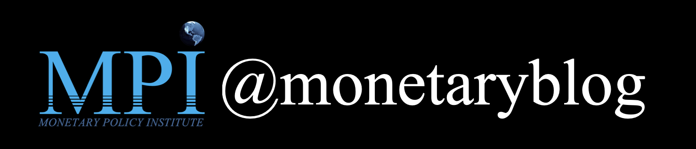
@LPROCHON
Workshop on monetary policy and income distribution (September, 2022)
Book on central banking, monetary policy and income distribution (March, 2023)
Workshop on monetary policy and income distribution w/ Bank of Italy (March, 2023)
Two symposiums on monetary policy on (functional) income distribution in ROPE (2023-4)
Symposium on conflict inflation (October, 2023)

Slide 4
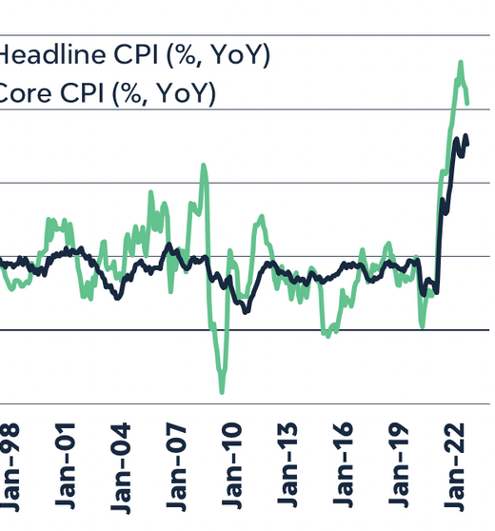
Inflation in Canada falls from 8.1% (June, 2022) -- highest since 1983 – to 5.9% now.
Immaculate Disinflation?

Slide 5
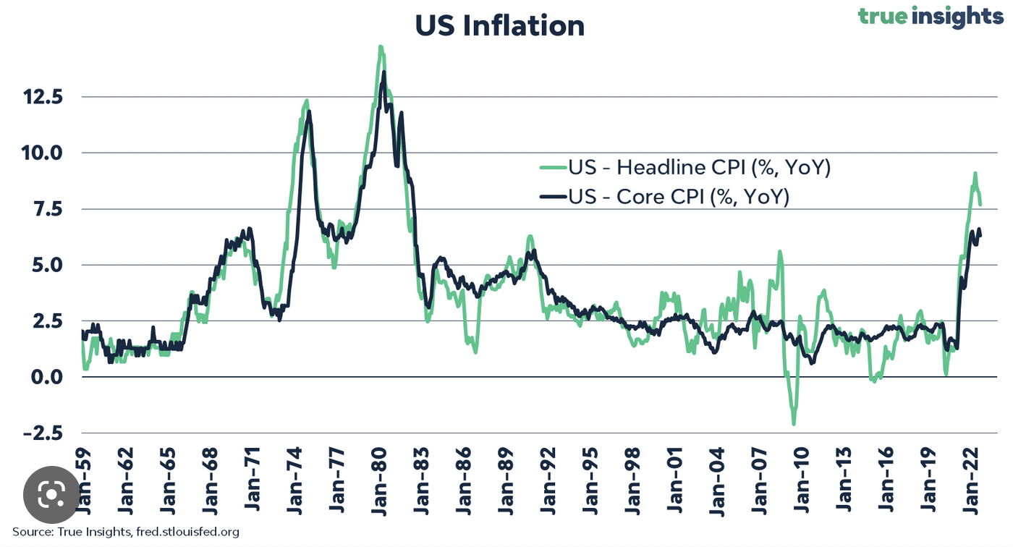

Slide 6
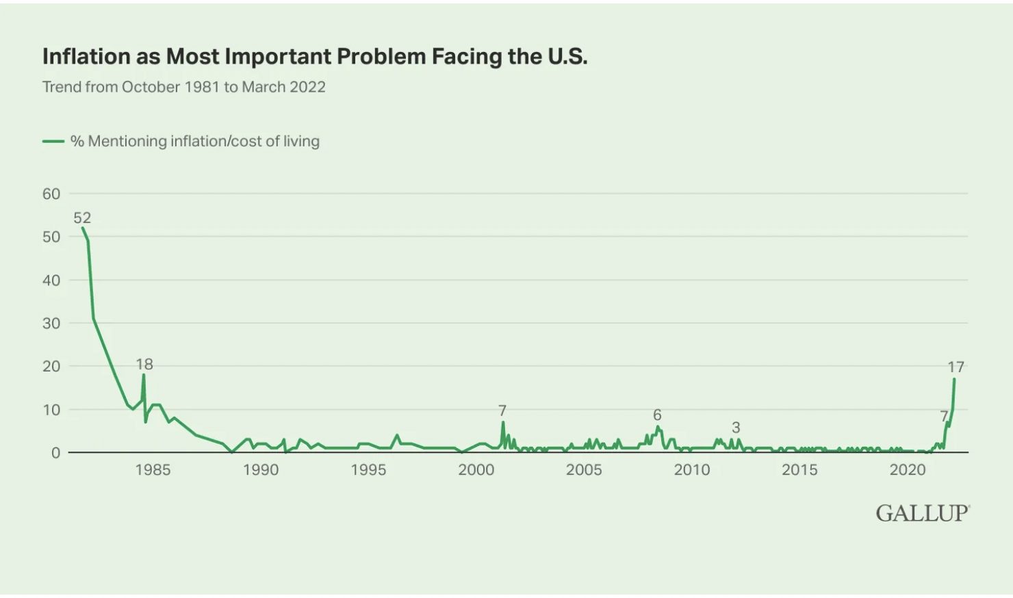
Martin Wolf (2023): “inflation genie is now out of his lamp.”
Not surprising: media certainly plays a role in propagating stories about “the inflation monster”, and “the year of extreme inflation”
Both quotes from left of centre economists
“Americans’ mentions of the government as the nation’s most important problem have risen significantly in the past month, while inflation remains the next most-cited issue.” (18%, March, 2023)

Slide 7
I. INFLATION HYSTERIA
Where does this inflation hysteria come from? The answer can only come from a political economy approach to central banking and monetary policy;
  Credibility, but credibility in whose eyes? Central banks only started reacting once they were accused of being non-credible by financial interests; there are always winners and losers from changes in interest rates; monetary policy is more about income distribution;
  Must be seen to be doing something;
Central banks have a communications problem. On the one hand, they claim to be fighting inflation on behalf of the working class, to help us make ends meet. On the other hand, central banks are prepared to create unemployment to bring inflation down.

Slide 8
INFLATION: WHAT DO WE KNOW?
Central bank view: low and stable inflation is best suited for economic growth. So, how destabilizing is inflation?
Greatest fear is the de-anchoring of inflation expectations and the emergence of a wage-price spiral; i) several surveys shows they are not unanchored; and ii)
“Economists and economic policymakers believe that households’ and firms’ expectations of future inflation are a key determinant of actual inflation. A review of the relevant theoretical and empirical literature suggests that this belief rests on extremely shaky foundations, and a case is made that adhering to it uncritically could easily lead to serious policy errors.”
Jeremy B. Rudd (Federal Reserve Board), Review of Keynesian Economics, 10 (1), Spring, pp. 25-45.

Slide 9
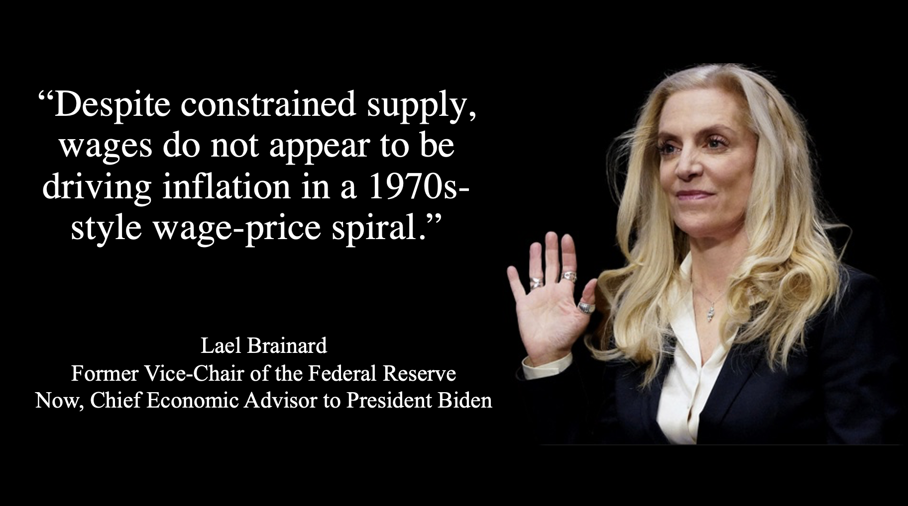

Slide 10
INFLATION: WHAT DO WE KNOW?
Former World Bank chief economist Michael Bruno and William Easterly (1995): “countries can manage to live with moderate – around 15–30 percent – inflation for long periods”;
Inflation becomes destabilizing at around 40%;
Confirmed by Dornbush and Fisher (2004; 2022): it is the central bank policies to reduce inflation that are destabilizing: “inflation hysteria”;

Slide 11
INFLATION: WHAT DO WE KNOW?
James Tobin (New York Times, 1974) warned us: “hysteria about inflation may lead to policies that keep economic progress well below its potential”;
Stiglitz (Project Syndicate; 2023): “further interest-rate hikes will have little to no effect – and will cause far-reaching problems of their own”;
What I called, the ‘Weaponization of inflation’: distributional effects

Slide 12
II. MONETARY AUSTERITY
Inflation peaked in early 2022 and has been coming down: how much of this is due to monetary policy? In other words, is monetary policy efficient?
Is there ‘immaculate disinflation’?
Alan Blinder (1982), speaking of inflation of 1980-81, says inflation come down because of ”special factors” (oil).
According to the European Central Bank: 100 Bp rate hike only reduces inflation by 0.1 to 0.2 pp.
Monetary Policy and TINA: “the only game in town” (The Economist)

Slide 13
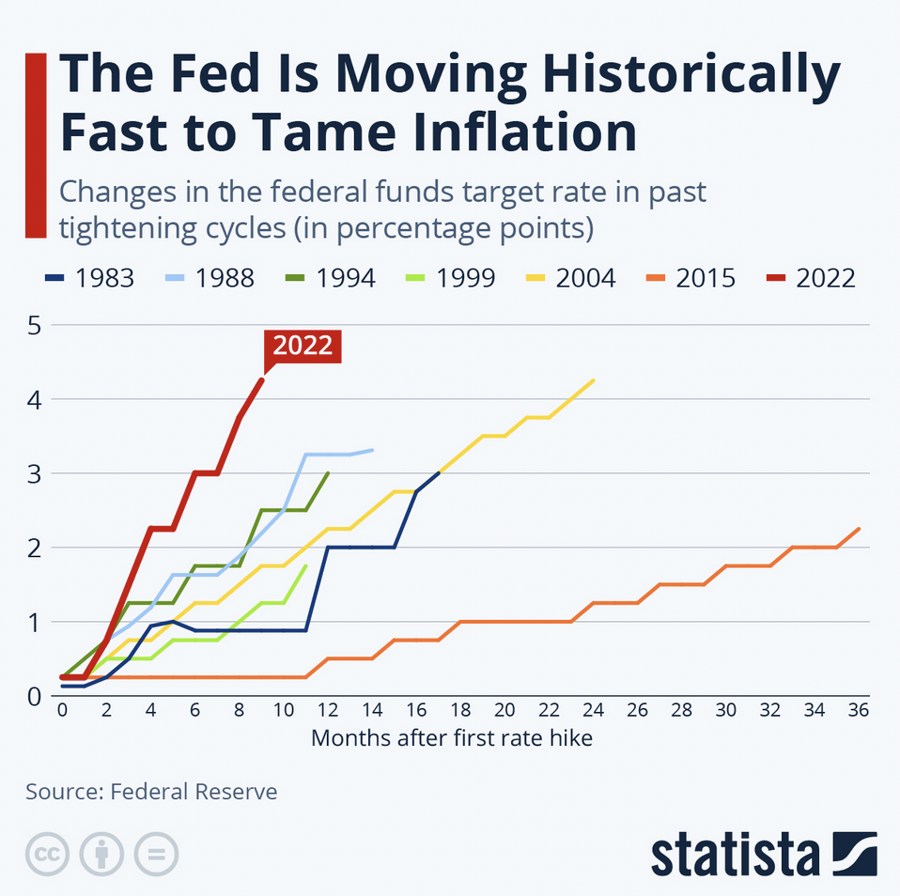
The most aggressive monetary policy response in Federal Reserve history;
But why?

Slide 14
III. SOURCES OF INFLATION
Three possible sources of inflation
  Demand-pull
  Cost-push
  Conflict inflation

Slide 15
i) DEMAND-PULL INFLATION
Results from excess demand: ”Too much money chasing too few goods”
Friedman: “Inflation is always and everywhere a monetary phenomenon”
Causes:
  Biden’s fiscal stimulus;
  Federal Reserve’s accommodating monetary policy contributed to an unprecedented overheating of the economy; interest rates were too low for too long;
  Pent-up pandemic savings;
Lawrence Summers: “the least responsible fiscal, macroeconomic policy we’ve have had for the last forty years”
  But for others: “it quickly became plain that the conventional wisdom that roots the inflationary upsurge in the Biden stimulus is seriously deficient” (Servaas Storm)

Slide 16
CURRENT MONETARY POLICY THINKING
Relies on the Phillips Curve: Central banks raise rates to reduce demand (too much money chasing too few goods), to increase unemployment and lower inflation
Bullard (2019): “U.S. monetary policymakers and financial market participants have long relied on the Phillips curve—the correlation between labor market outcomes and inflation—to guide monetary policy”;
NBER (2019), “the relationship between inflation and the unemployment rate is a key input to the design of monetary policy”.

Slide 17
CURRENT MONETARY POLICY THINKING
So, current design of monetary policy rests on engineering unemployment: fight against inflation is done on the backs of workers; this is the Phillips Curve;
But there is so little empirical evidence to support this relationship;
“The slope of the Phillips curve itself has been getting flatter, ever since the1980s, and is now quite small. … there is no well-defined natural rate of unemployment, either statistically or conceptually.” (Solow, 2018, p.423);
Claudio Borio, has recently argued that “the response of inflation to a measure of labour market slack has tended to decline and become statistically indistinguishable from zero. In other words, inflation no longer appears to be sufficiently responsive to tightness in labour markets” (Borio, 2017, p. 2);
“The slope of the Phillips curve—a measure of the responsiveness of inflation to a decline in labor market slack—has diminished very significantly since the 1960s. In other words, the Phillips curve appears to have become quite flat.” (Janet Yellen, 2019);

Slide 18
CURRENT MONETARY POLICY THINKING
As a result, you need a tremendous increase in unemployment to reduce inflation;
But central banks just can’t give up on this model: if Powell were to admit this view, then the whole foundation of current monetary thinking collapses;
The central banker has no clothes;

Slide 19
MONETARY AUSTERITY
“The standard of living of the average American has to decline.”
Paul Volcker (1979)
“Higher interest rates will also bring some pain to households.”
Jerome Powell, Chair, Federal Reserve Bank (2022)
“To bring price increases down to 2%, we may need to tolerate unemployment of 6.5% for two years.”
Jason Furman, Former Chair, Council of Economic Advisers
Obama Administration
TOLERATE???

Slide 20
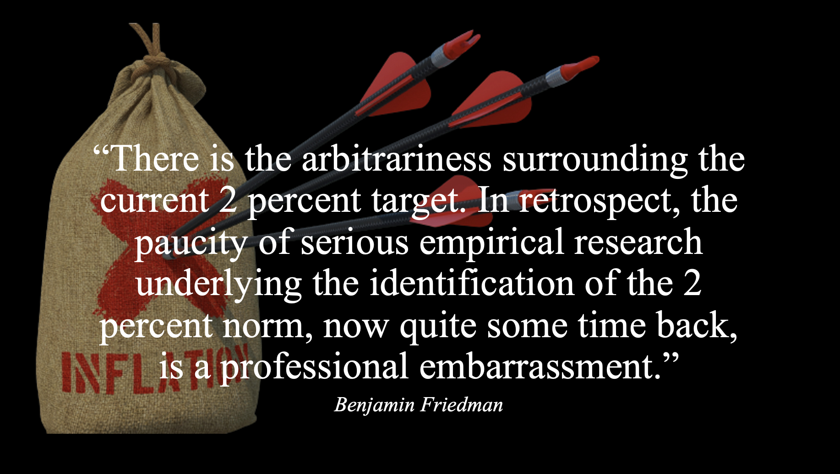
SPEAKING OF THAT 2% TARGET

Slide 21
ii) COST-PUSH INFLATION
According to Joe Stiglitz, “There is overwhelming evidence that the main source of inflation was pandemic-related supply shocks.”
In the current context, there has been 3 sources of inflation identified:
  Oil and gas
  Pandemic-related bottle necks
  Profit margins

Slide 22
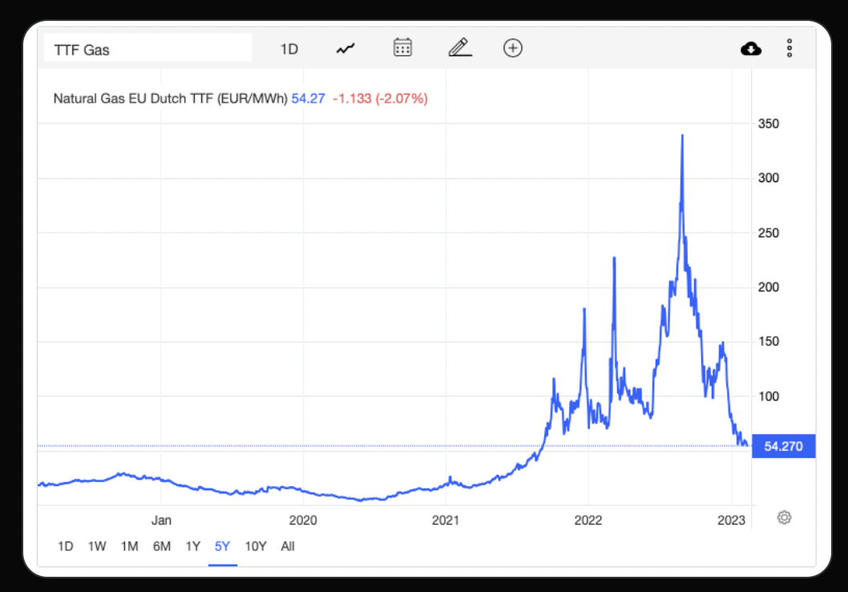
ii) COST-PUSH INFLATION
Price of oil, one of the dominant sources of current inflation, has come down considerably (Summer, 2021)

Slide 23
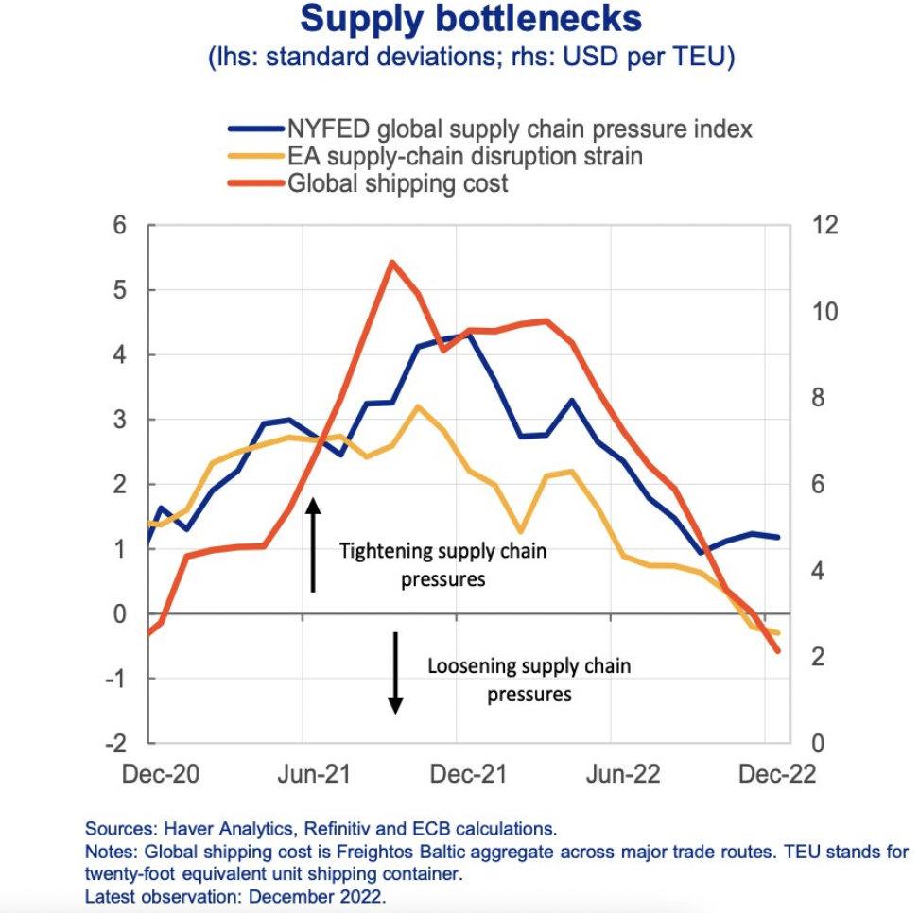
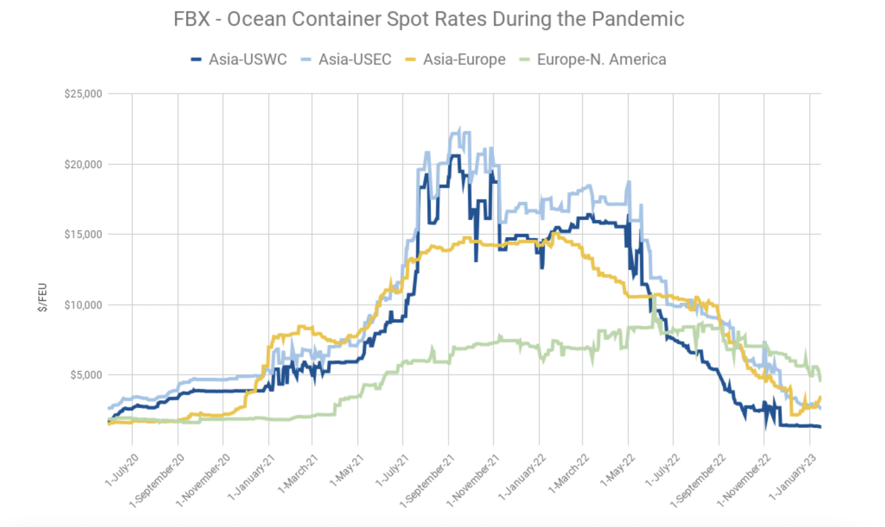
ii) COST-PUSH INFLATION
Source: Freightos
At the height of the crisis, accounted for 50% of inflation

Slide 24
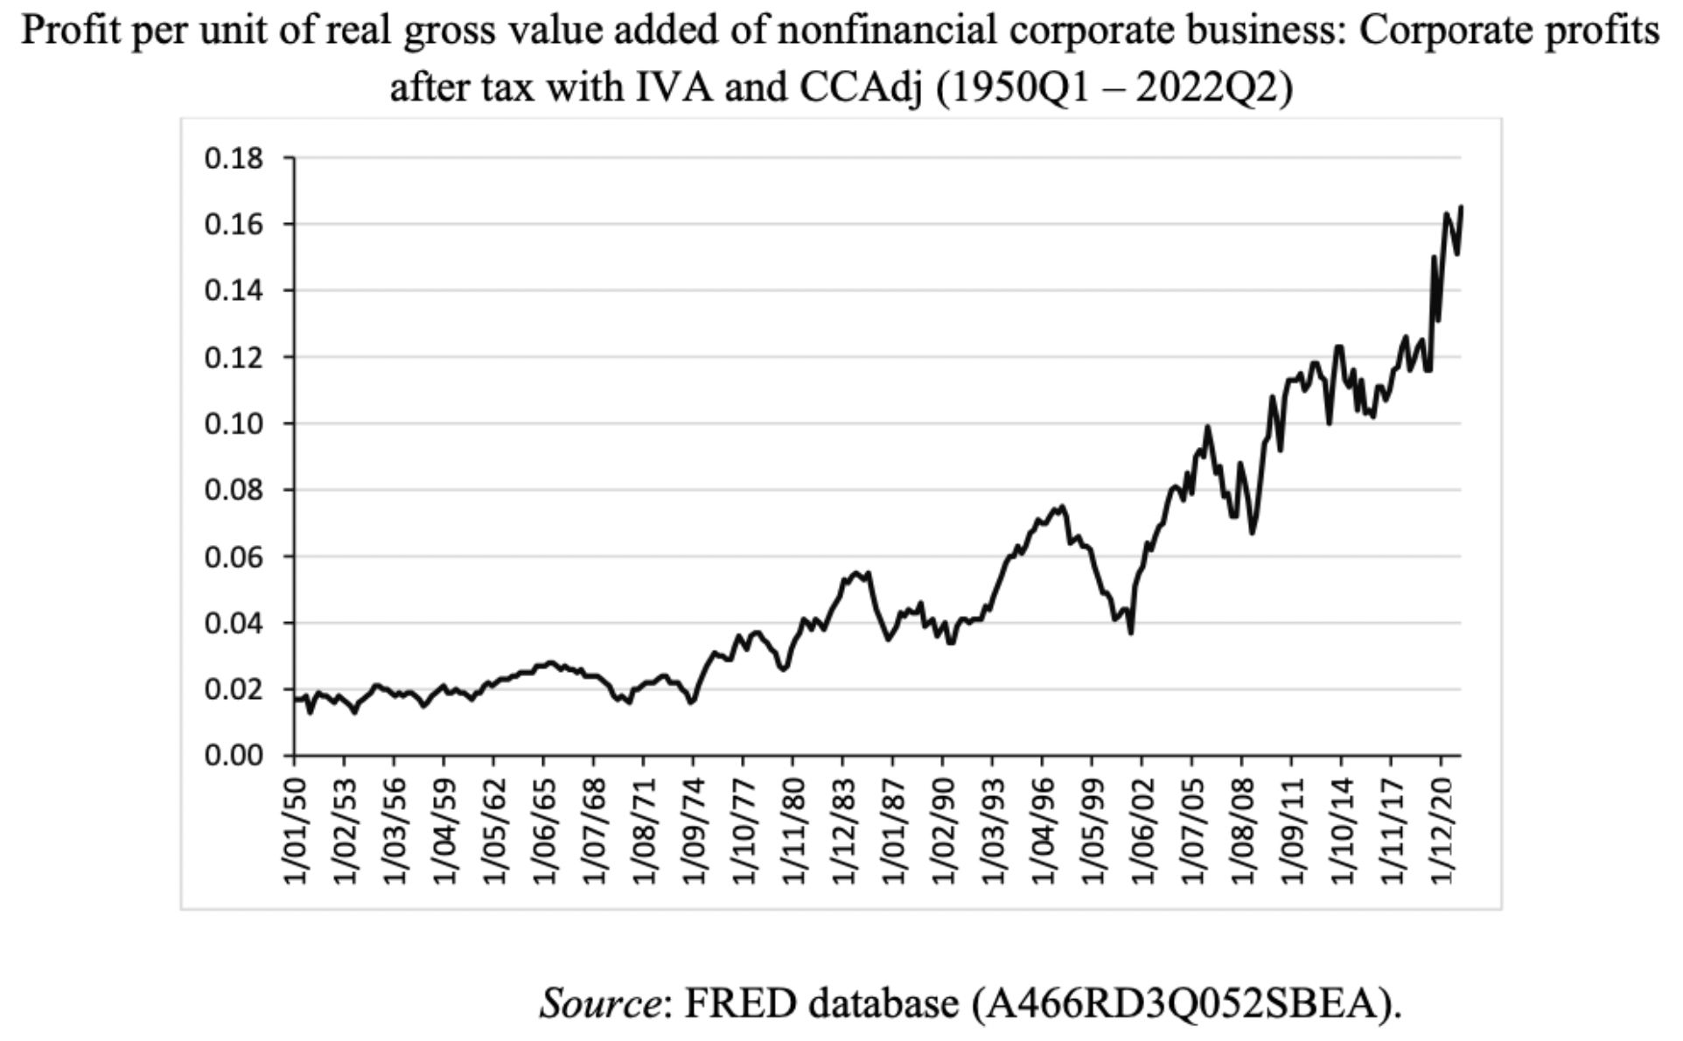
PROFIT INFLATION
Higher profit margins as a source of inflation:
Josh Bivens (US)
David MacDonald (Canada)
Jim Stanford (Australia)
For Gabriel Zucman, post-tax corporate profits % of GDP at a record high

Slide 25
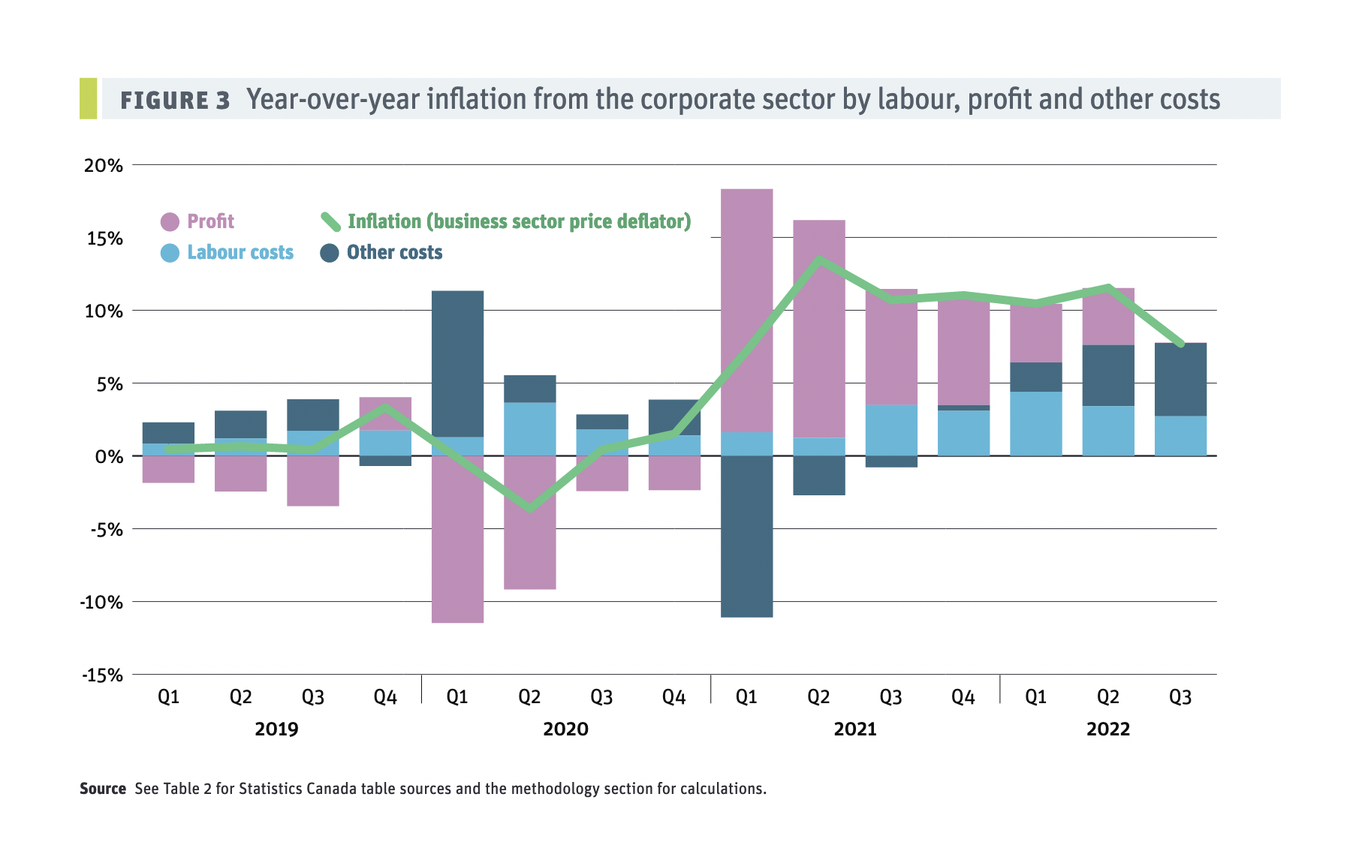
PROFIT INFLATION
According to Jim Stanford, without excess profits, inflation would be half what it is now; within the RBA’s (Australia) inflation target band.
On March 2, 2023, an internet Yahoo poll (not scientific) found 86% of respondents think grocery stores and hiking prices more than they should
Source: David MacDonald
Canadian Centre for Policy Alternatives
“Where are your Inflation Dollars Going?”

Slide 26
PROFIT INFLATION
Increasingly, empirical evidence seems to be confirming this trend. For instance, according to Paul Donovan, chief economist at UBS Global Wealth Management: "It's clear that profit expansion has played a larger role in the European inflation story in the last six months or so.”
A news story by Francesco Canepa (March, 2, 2023; Reuters), cl;aims that the ECB recently discussed this matter: “Huddled in a retreat in a remote Arctic village, European Central Bank policymakers faced up last week to some cold hard facts: companies are profiting from high inflation while workers and consumers foot the bill.”

Slide 27
CONCLUSION I
If inflation is coming down, unrelated to central bank policy; was this aggressive policy necessary?
Is this a case of “immaculate disinflation?”
On another note: income distribution: banks are making record profits from higher rates on loans, but also from increased interest on settlement banalces as a result of QE

Slide 28
CONCLUSION I
Undoubtedly, interest rates were too low for too long (in the absence of proper regulations, it contributed to MASSIVE wealth creation (remember: “there are always winner and losers”);
What is the ‘proper’ level of interest rates? Difficult question to answer;

Slide 29
iii) GIBSON’S PARADOX
ON A SIDE NOTE: Monetary austerity can LEAD TO inflation, not less
“Kaldor (1982, p. 63) argued that ‘interest costs are passed on in higher prices in much the same way as wage costs.”
An Inquiry into the Currency Principle, Thomas Tooke (1844) wrote the same thing:
  “A general reduction in the rate of interest is equivalent to or rather constitutes a diminution of the cost of production...the diminished cost of production hence arising would, by the competition of the producers, inevitably cause a fall of prices of all the articles into the cost of which the interest of money entered as an ingredient. And the presumption accordingly is, that the very reduced rate of interest which has prevailed within the last two years must have operated as one of the contributing causes of the great reduction of prices of some of our most important manufactures which has occurred coincidently with reduction in the rate of interest.”

Slide 30
III) GIBSON’S PARADOX
John Kenneth Galbraith, The Affluent Society (1958):
  “Business firms feel the impact of monetary policy initially in the form of a change in factor cost or availability—specifically, in the cost or availability of credit for capital. Large firms and those with substantial market power are able, as we have seen, to pass this cost increase along to customers”.

Slide 31
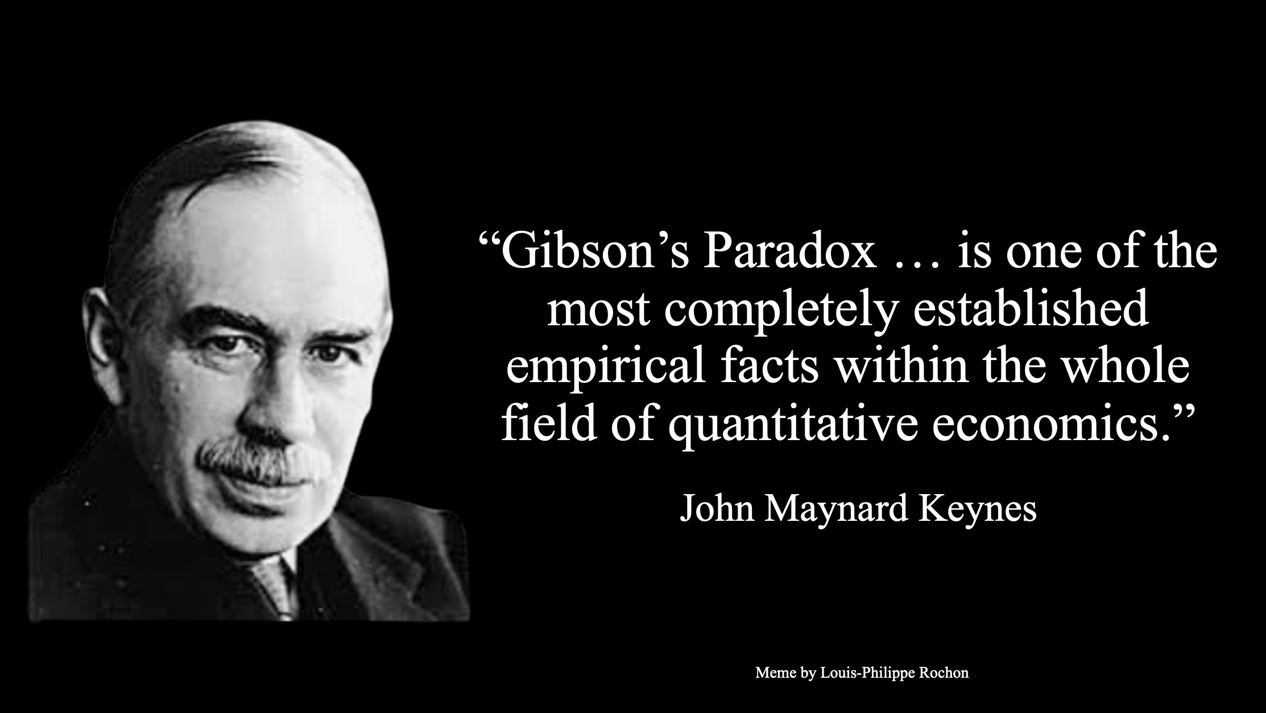

Slide 32
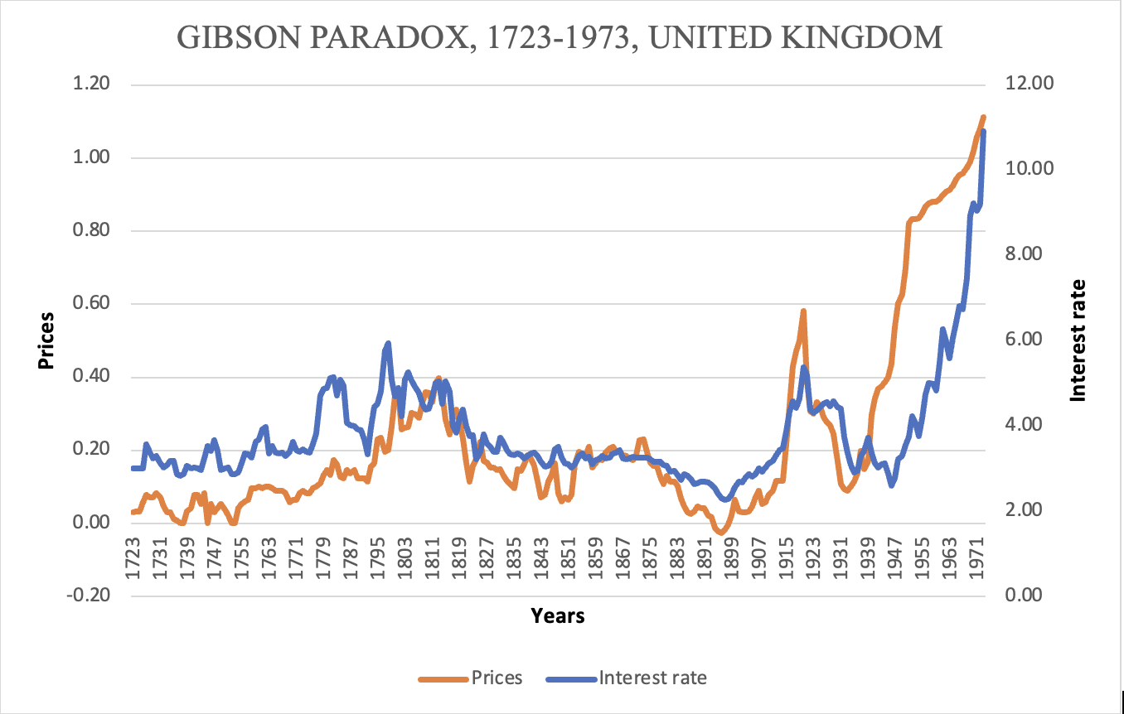
III) GIBSON’S PARADOX

Slide 33
CONCLUSION II
While most inflation is cost-push, I am somewhat uncomfortable with this approach as it can easily lead to blaming workers (unions) with higher inflation;
There is some history in PK economics on this (Robinson, for instance);
That’s why I prefer to refer to inflation as conflict drive as it can open the door to not just wage-price inflation but also to profit-price inflation;

Slide 34
CONFLICT INFLATION
Inflation is always and everywhere a conflict phenomenon, both at the national and international levels;
We also need to redefine conflict in light of ‘financialized capitalism’
Maybe there is no wage pressure (wage-price inflation), but there is still conflict (profit-price inflation)
Workers only play catch up … they don’t lead the charge for higher wages; firms initiate the conflict by targeting a profit share/higher prices;

Slide 35
MONETARY POLICY AND THE INHERENT BIASES
It’s about income distribution, both personal and functional
  Implications for monetary policy;
  Rejection of fine-tuning as ineffective)
Lavoie (1996, p. 537):
  “It then becomes clear that monetary policy should not so much be designed to control the level of activity, but rather to find the level of interest rates that will be proper for the economy from a distribution point of view. The aim of such a policy should be to minimize conflict over the income shares, in the hope of simultaneously keeping inflation low and activity high.”

Slide 36
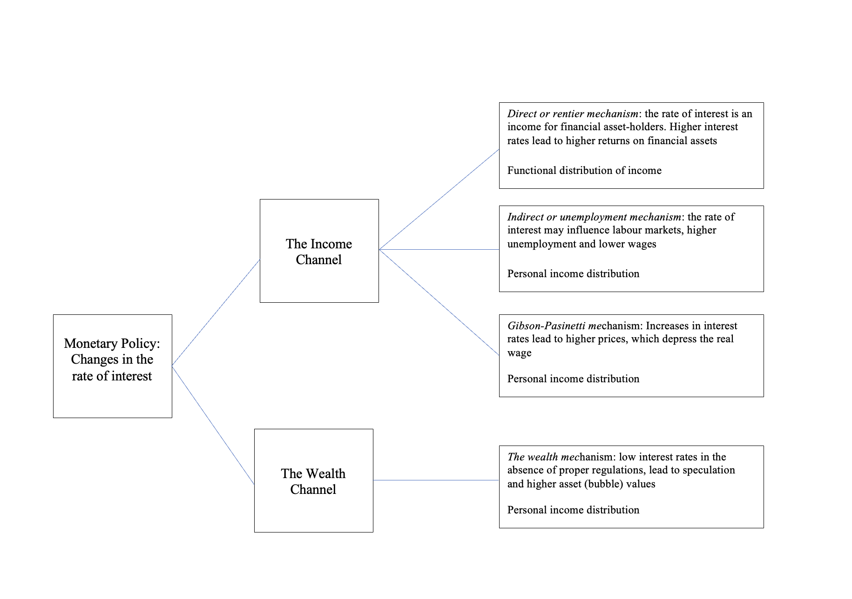
From a forthcoming paper

Slide 37
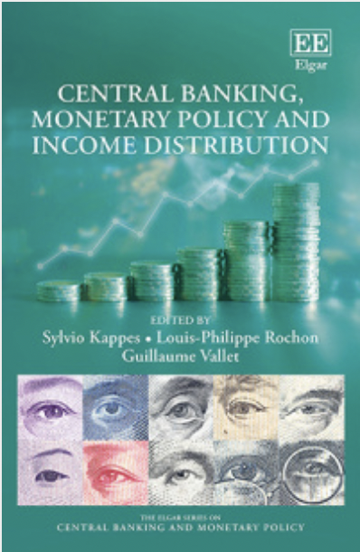
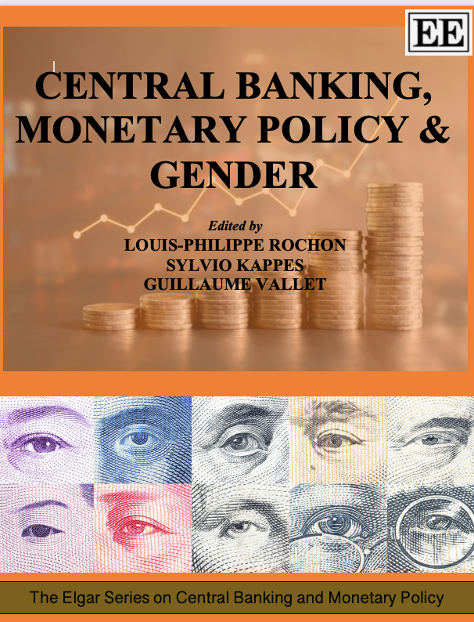
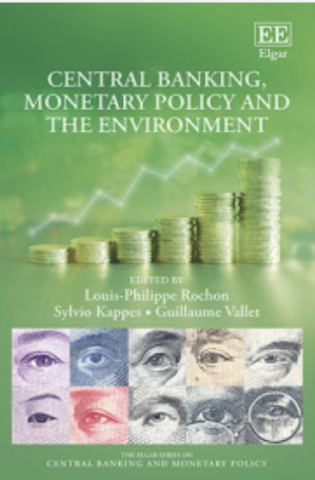
II CONCLUSION
Monetary policy is about income distribution: a central focus of my work with Sylvio Kappes;
class bias gender-bias climate-bias)

Slide 38
III CONCLUSION
Some thoughts on “immaculate disinflation”
Reduction of inflation without impacting unemployment (very soft landing)
But even if true, it does not mean that monetary policy does not impact workers:

Slide 39
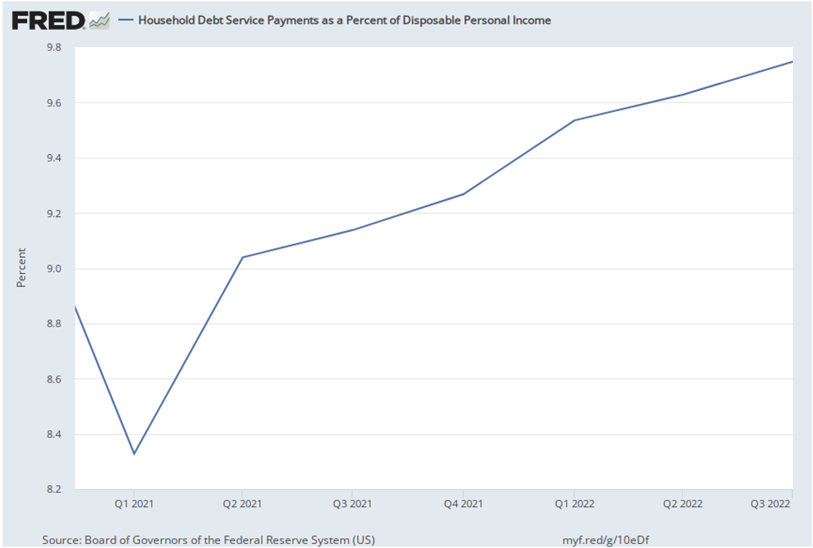
Monetary policy has profound impact on households and workers:
What has impacted workers more? Inflation or monetary austerity?

