Slide 1

WHEN ARE CENTRAL
BANKING & INTEREST RATES
A HINDRANCE TO REINDUSTRIALIZATION?
LOUIS-PHILIPPE ROCHON
Full Professor, Laurentian University
Editor-in-Chief, Review of Political Economy
Founding Editor Emeritus, Review of Keynesian Economics
Consulting Editor, Advances in Economics Education
Co-Director, Monetary Policy Institute
Co-Editor, Central Banking and Monetary Policy Series
@lprochon @monetaryblog
Universidade Estadual Paulista
August 14, 2023
Benoit Genest Rouillier

Slide 2
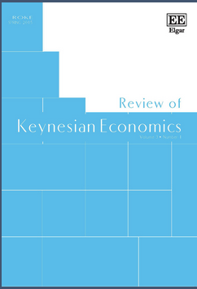
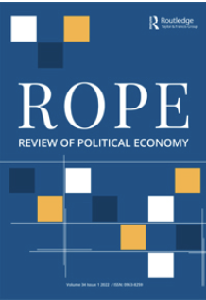
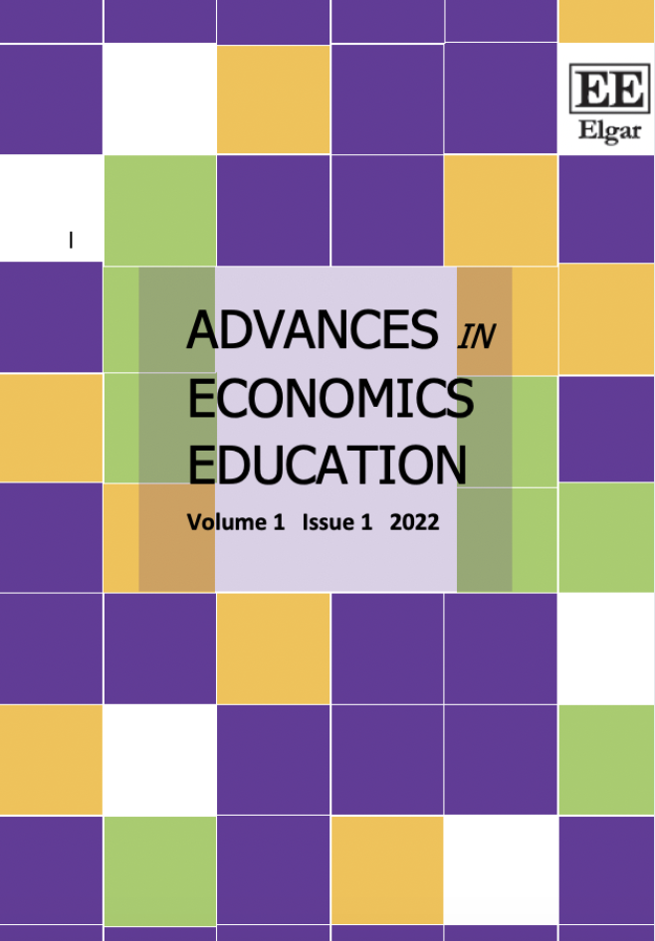

Slide 3
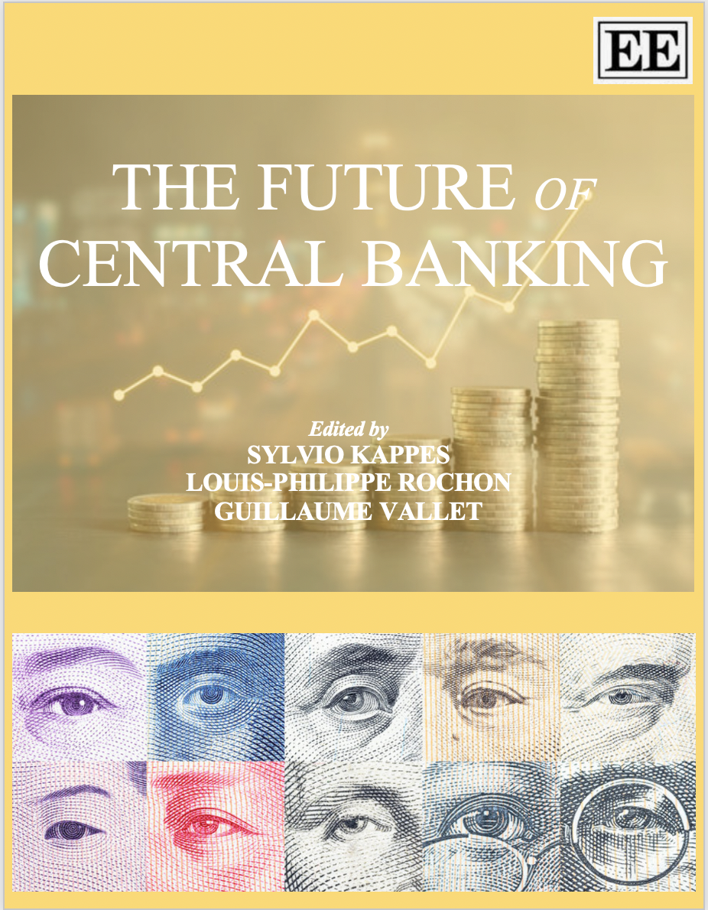
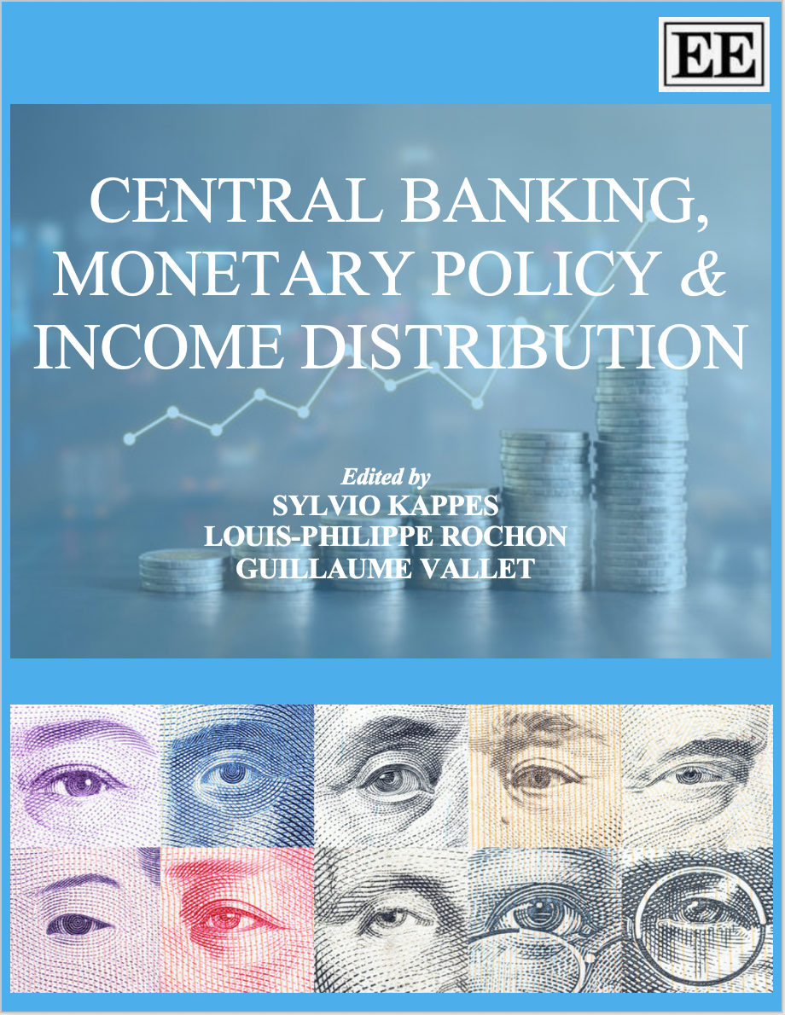
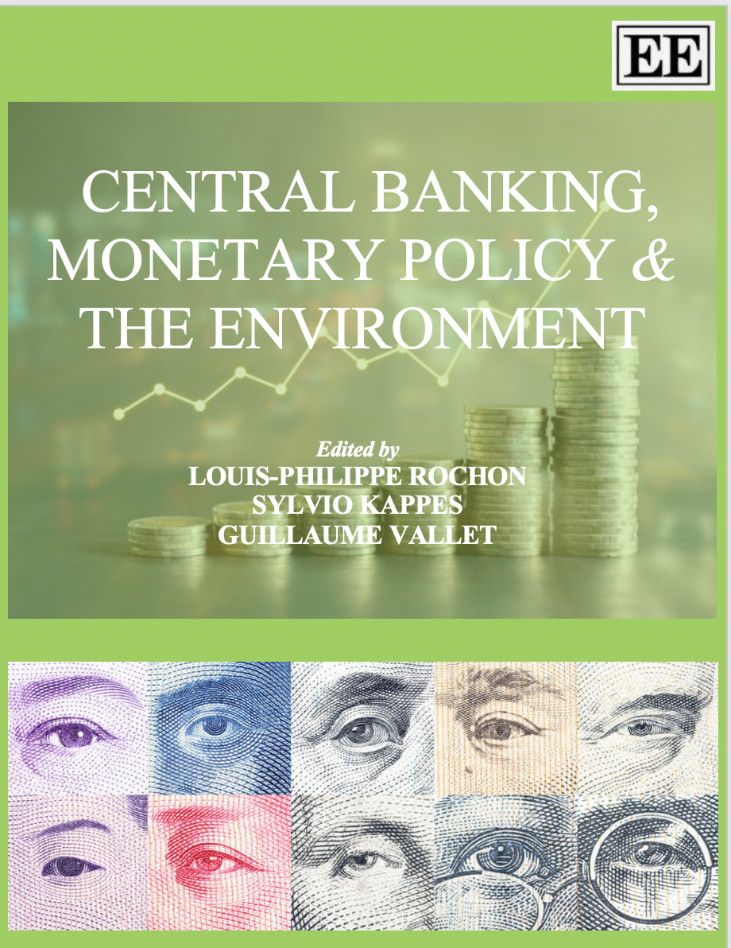
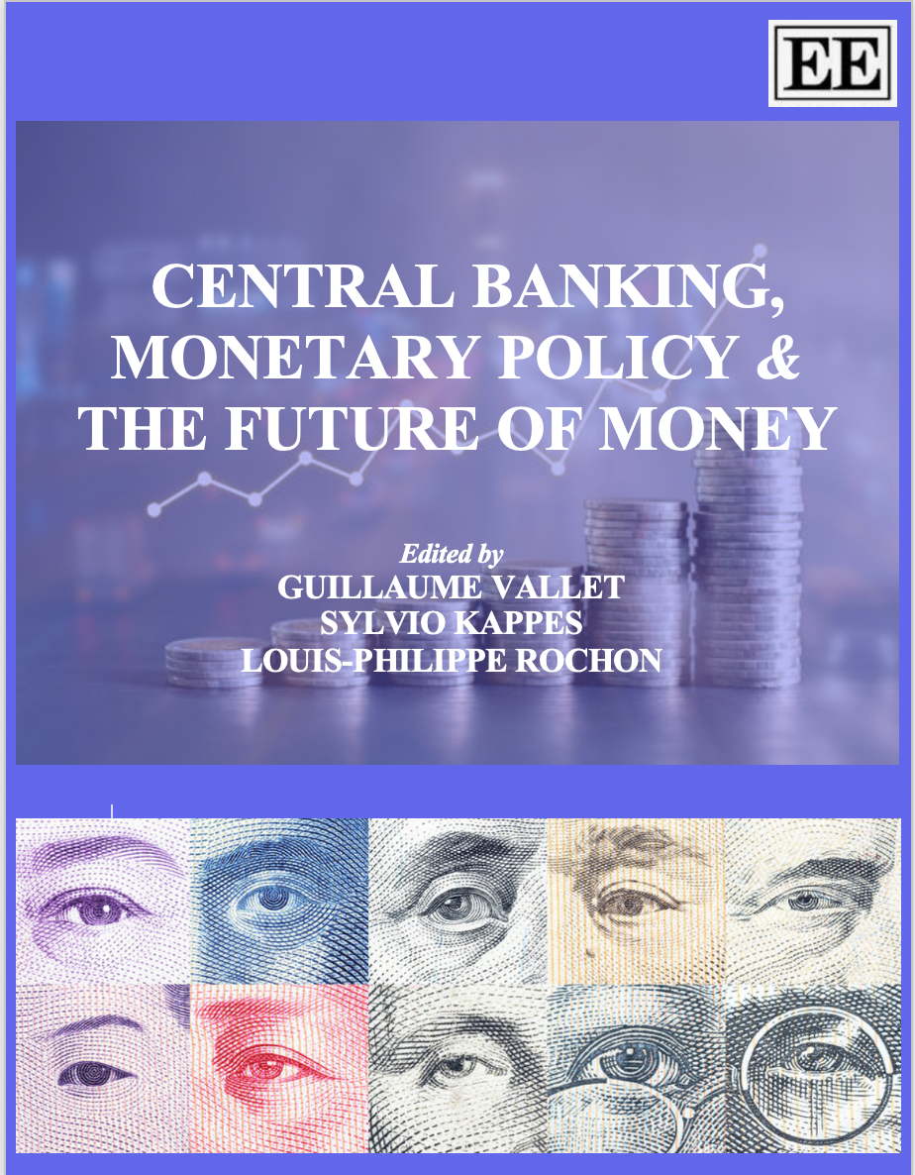
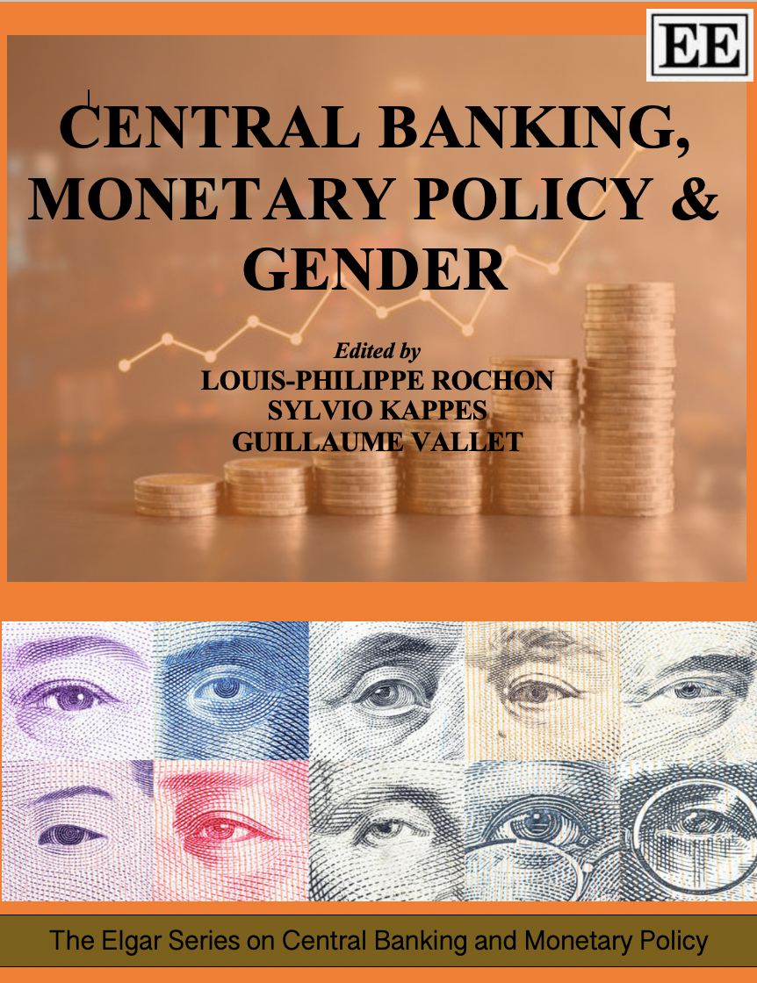
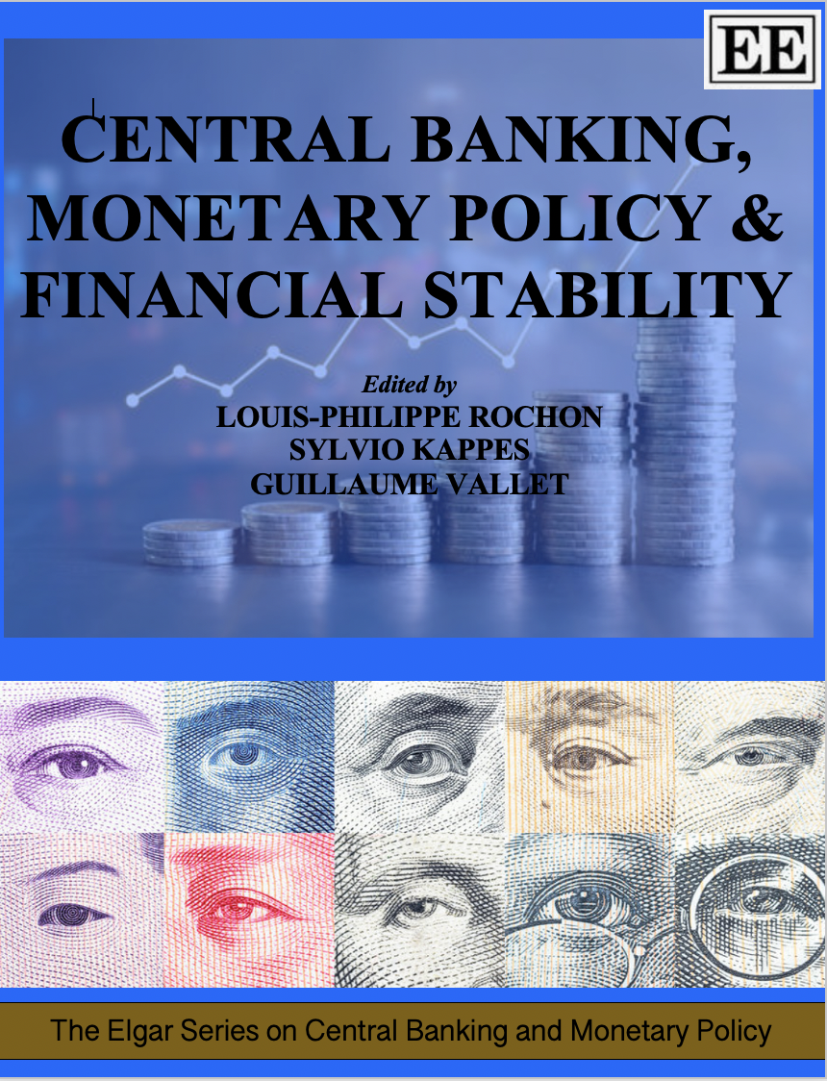
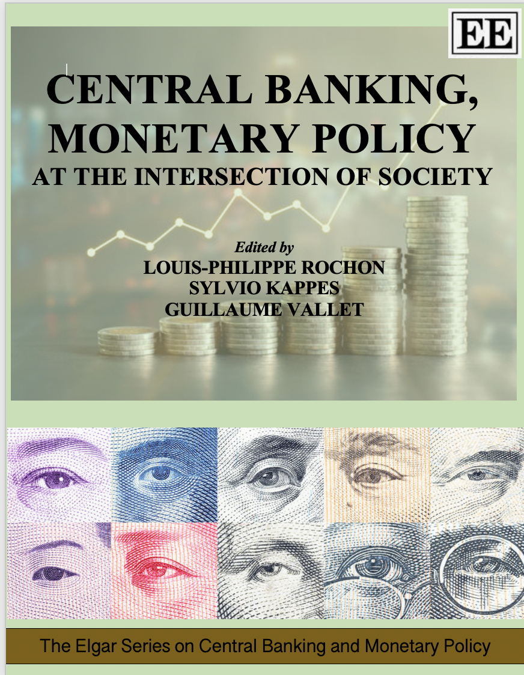
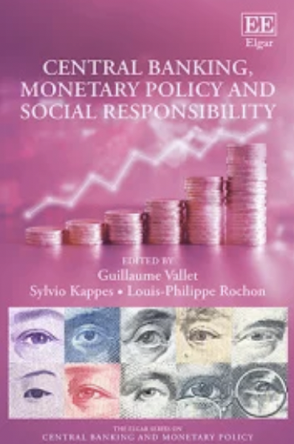
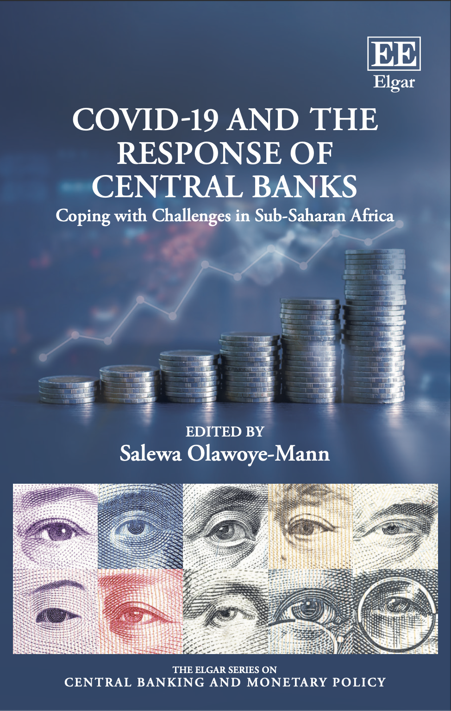
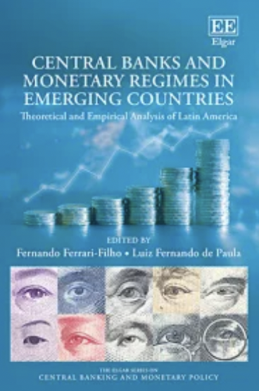
“This new series, planned to consist of a dozen books, is an ambitious attempt to ascertain and analyze all of the current and potential tasks and responsibilities of central bankers, as well as their current and likely future challenges. The editors have done a terrific job in gathering contributions from both experienced scholars and innovative young researchers”.
Marc Lavoie

Slide 4

@LPROCHON
Workshop on monetary policy and income distribution (September, 2022)
Book on central banking, monetary policy and income distribution (March, 2023)
Workshop on monetary policy and income distribution w/ Bank of Italy (March, 2023)
Two symposiums on monetary policy on (functional) income distribution in ROPE (2023-4)
Symposium on conflict inflation (October, 2023)

Slide 5

JOHN MAYNARD KEYNES
NI

Slide 6
Central banks have always been at the heart of the macroeconomic policy debate;
Today, however, we live in an age of ‘monetary policy dominance’: fiscal policy plays very little role, except perhaps in times of crises but there is no ‘return of the Master’
This leaves the place entirely to monetary policy to regulate economic activity and control inflation

Slide 7
Yet, this assumes a particular or specific monetary policy transmission mechanism;
Changes in the rate of interest impacts output and unemployment and therefore inflation
Elegant, simple model: but does it work? Is monetary policy effective in controling inflation : inflation targeting

Slide 8
It relies on an elastic IS curve and an elastic Phillips curve; “The more sensitive the response, the more potent is monetary policy” (Hall, 1977): effectiveness of monetary policy.
Yet there is evidence that both relationships are statistically negligible
“It is a long and uncertain chain of events from an adjustment in the interest rate controlled by the central bank to a desired change in the rate of inflation” (Arestis and Sawyer, 2003, p. 5).
There may be, as Keynes tells us, “several slips between the cup and the lip.”

Slide 9
First, let’s question the very notion of inflation targeting:
In the 1980s, inflation was coming (starting around 1984) down before the introduction of IT, in 1990 (New Zealand);
As Benjamin Friedman claimed recently, “there is the arbitrariness surrounding the current 2 percent target. In retrospect, the paucity of serious empirical research underlying the identification of the 2 percent norm, now quite some time back is a professional embarrassment” Friedman (2018, p. 187).
Emmanuel Carré (2014): “economic theories have played a limited role in the creation of inflation targeting.”

Slide 10
This is of course an empirical question. But there are empirical indications that this much-coveted IS relationship is problematic. For instance, according to Cynamon, Fazzari and Setterfield (2013, p. 13),
  “The transmission mechanism from monetary policy to aggregate spending in new consensus models relies on the interest sensitivity of consumption. It is difficult, however, to find empirical evidence that households do indeed raise or lower consumption by a significant amount when interest rates change. Some authors have generalized the link to include business investments (see Fazzari, Ferri, and Greenberg, 2010 and the references provided therein) but a robust interest elasticity of investment has also been difficult to demonstrate empirically.”
Sharpe and Suarez (2015, p. 1; reconfirmed in 2021)
  “A large body of empirical research offers mixed evidence, at best, for substantial interest-rate effects on investment. [our research] find that most firms claim their investment plans to be quite insensitive to decreases in interest rates, and only somewhat more responsive to interest rate increases.”

Slide 11
THE IS CURVE
Krugman (2018) reaches a similar conclusion:
  “It’s a dirty little secret of monetary analysis that changes in interest rates affect the economy mainly through their effect on the housing market and the international value of the dollar (which in turn affects the competitiveness of U.S. goods on world markets). Any direct effect on business investment is so small that it’s hard even to see it in the data. What drives such investment is, instead, perceptions about market demand.”
Kopp, Leigh, Mursula and Tambunlertchai (IMF, 2019, p. 4) reach the same conclusion. According to the authors, there “appears to be little unexplained component of business investment beyond the expected demand effect. Other factors, such as reductions in the cost of capital, thus appear to have played a relatively minor role.”
An old truth: Robert Hall (1977) stated the “the evidence is disappointingly weak”

Slide 12
How about HANK, RANK and TANK models
Still researching. So far:
  “The strong response of aggregate consumption to movements in real rates that accounts for the large direct effects in RANK is questionable in light of empirical evidence. Macroeconometric analysis of aggregate time-series data finds a small sensitivity of consumption to changes in the interest rate after controlling for income.” (Kaplan, Moll, and Violante, 2018, p. 698)
In HANK models
  “the direct effects of interest rate shocks in our HANK model are always small while the indirect effects can be substantial …. households are highly sensitive to labor income shocks but are not responsive to interest rate changes.” (Kaplan, Moll, and Violante, 2018, p. 699)

Slide 13
Bullard (2019): “U.S. monetary policymakers and financial market participants have long relied on the Phillips curve—the correlation between labor market outcomes and inflation—to guide monetary policy.”
NBER (2019), “the relationship between inflation and the unemployment rate is a key input to the design of monetary policy.”
BUT …
Claudio Borio, has recently argued that “the response of inflation to a measure of labour market slack has tended to decline and become statistically indistinguishable from zero. In other words, inflation no longer appears to be sufficiently responsive to tightness in labour markets” (Borio, 2017, p. 2).
Borio (2017, p. 2): “the response of inflation to a measure of labour market slack has tended to decline and become statistically indistinguishable from zero. In other words, inflation no longer appears to be sufficiently responsive to tightness in labour markets”
Arestis and Sawyer (2003, p. 5): “It is a long and uncertain chain of events from an adjustment in the interest rate controlled by the central bank to a desired change in the rate of inflation.”
Gordon (1989): “was there ever a Phillips curve”?

Slide 14
“Various inflation drivers have been shaping the inflation process in ways that at times have been difficult to fully understand. The heightened uncertainty has natur15ally carried over to inflation forecasting” (BIS, 2015, p. 74)
“The slope of the Phillips curve itself has been getting flatter, ever since the1980s, and is now quite small. … there is no well-defined natural rate of unemployment, either statistically or conceptually.” (Solow, 2018, p.423).
“The slope of the short-run inflation– unemployment relationship has flattened” (Gordon, 2018, p. 427).
“The slope of the Phillips curve—a measure of the responsiveness of inflation to a decline in labor market slack—has diminished very significantly since the 1960s. In other words, the Phillips curve appears to have become quite flat.” (Janet Yellen, 2019)

Slide 15
A labour specialist at the US Bureau of Labor Statistics, Politano (2021, online), has concluded that "Over the last 20 years, the Phillips curve relationship has nearly completely broken down in the United States".
Mary C. Daly, President of the Federal Reserve Board of San Francisco (see Daly, 2019), who argues that "As for the Phillips curve… most arguments today center around whether it’s dead or just gravely ill. Either way, the relationship between unemployment and inflation has become very difficult to spot."

Slide 16
Despite this, many at the federal Reserve “assume” the existence of the Phillips Curve:
Jerome Powell (2018): “the Phillips curve continues to be meaningful for monetary policy”. It was simply “hibernating”;
Dennis Lockhart (president of the Federal Reserve Bank of Atlanta):
  “I think a policymaker has to act on the view that the basic relationship in the Phillips curve between inflation and [un]employment will assert itself in a reasonable period of time as the economy tightens up, as the resource picture in the economy tightens.”

Slide 17
“All of the forgoing examples show that central bankers are not yet willing to discard the Phillips curve as a policy tool, even though the evidence for a downward sloping curve is meager” (Dorn, 2020)
“Without the PC, the whole complicated paraphernalia that underpins central bank policy suddenly looks very shaky. For this reason, the Phillips Curve will not be abandoned lightly by policy makers” (Gavin Davies, in the FT, 2017)

Slide 18
Roots: Walter Heller (economic advisor to Kennedy)
Rules vs discretion debate
Joan Robinson recognized this problem as early as 1943: "The regulating effect of changes in the rate of interest was at best very weak" (see 1943, p. 26), and again in 1952, where she describes as a 'false scent' the use of counter-cyclical monetary policy, and rejects: "the conception of an economy which is automatically held on a path of steady development by the mechanism of the rate of interest ... But it is by no means easy to see how the monetary mechanism is supposed to ensure how that the rate of interest actually assumes its full employment value. ... The automatic corrective action of the rate of interest is condemned by its very nature to be always too little and too late" (see Robinson, 1952, pp. 73-74).

Slide 19
So the costs of fine tuning can be large: “Because reaction functions rely on fine-tuning the economy as needed, the central bank’s policy obsession with inflation often translates into repeated increases in the rate of interest until the economy finally deflates (or collapses) in the misguided pursuit of a ‘soft landing’” (Rochon and Setterfield, 2008, p. 15).
What I called elsewhere, the pursuit of the Holy Grail.
The same conclusion was reached by Lavoie (2014, p. 235), “inflation control can be achieved only at the cost of large losses in economic activity.”

Slide 20
The nature of inflation
  Monetary policy would only theoretically work if inflation was the result of demand-side issues;
  But even if demand is at the root of inflation, then given the arguments so far, would monetary policy work?
  BUT what is inflation is the result of supply-side problems: conflict over the size of the distributive pie, or bottle necks as it seems to be the case now in 2022?
  What then: how can raising rates solve bottlenecks?

Slide 21
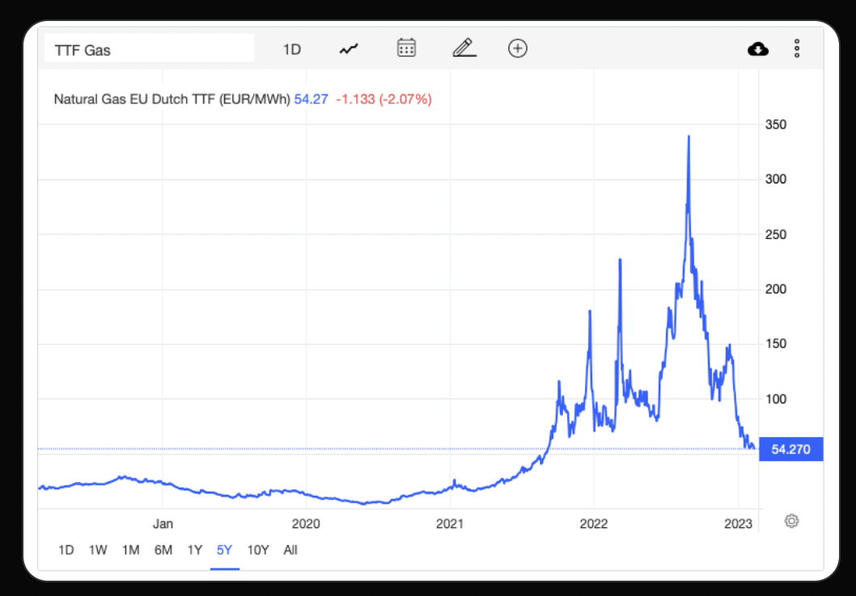
Price of oil, one of the dominant sources of current inflation, has come down considerably (Summer, 2021)

Slide 22
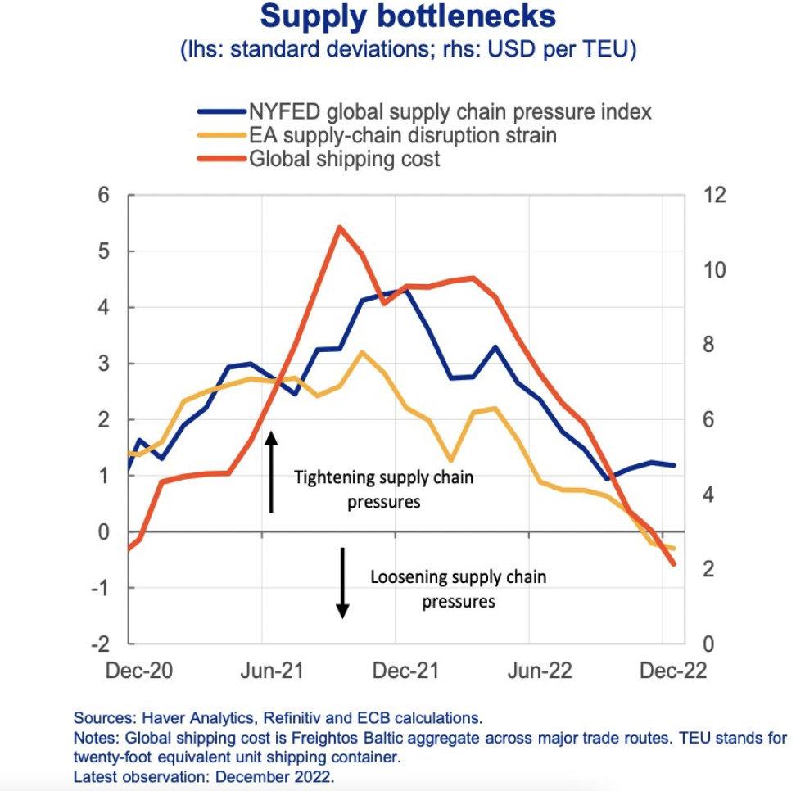
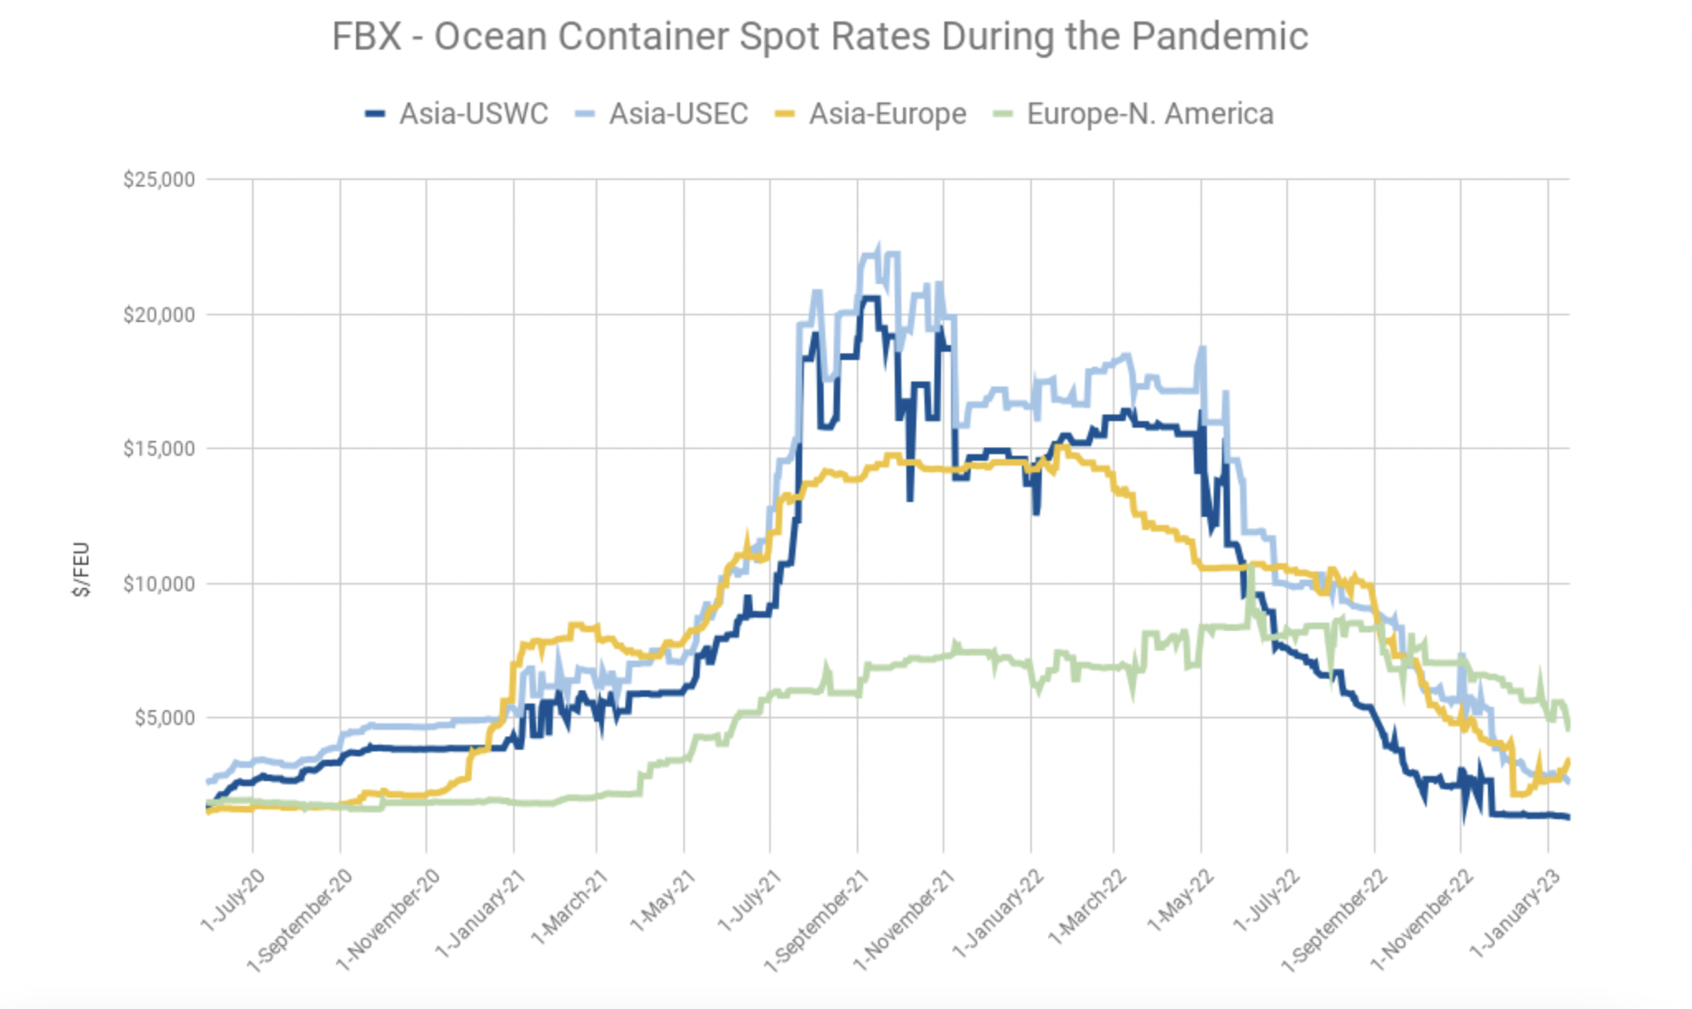
Source: Freightos
At the height of the crisis, accounted for 50% of inflation

Slide 23
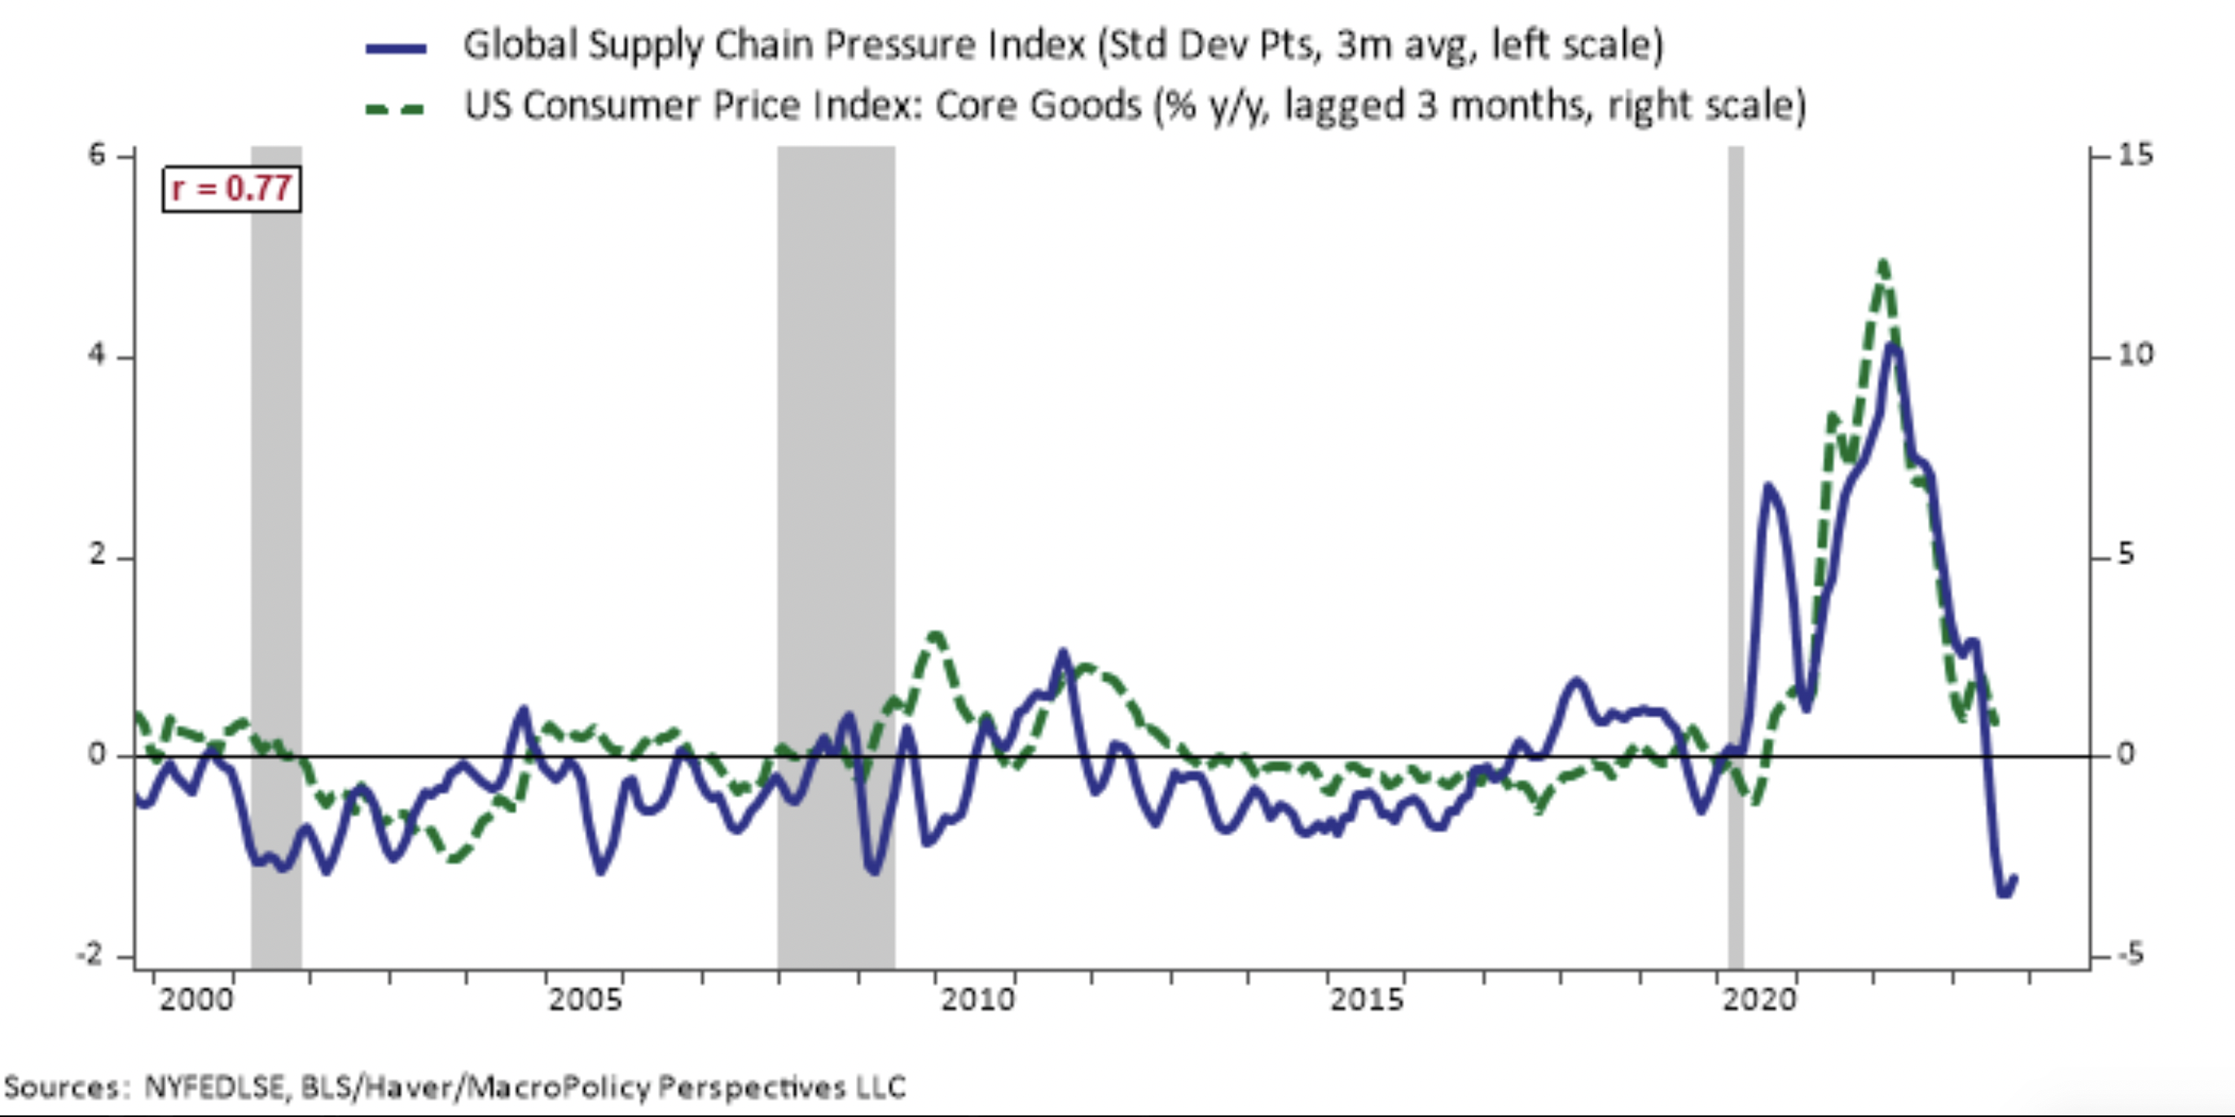

Slide 24
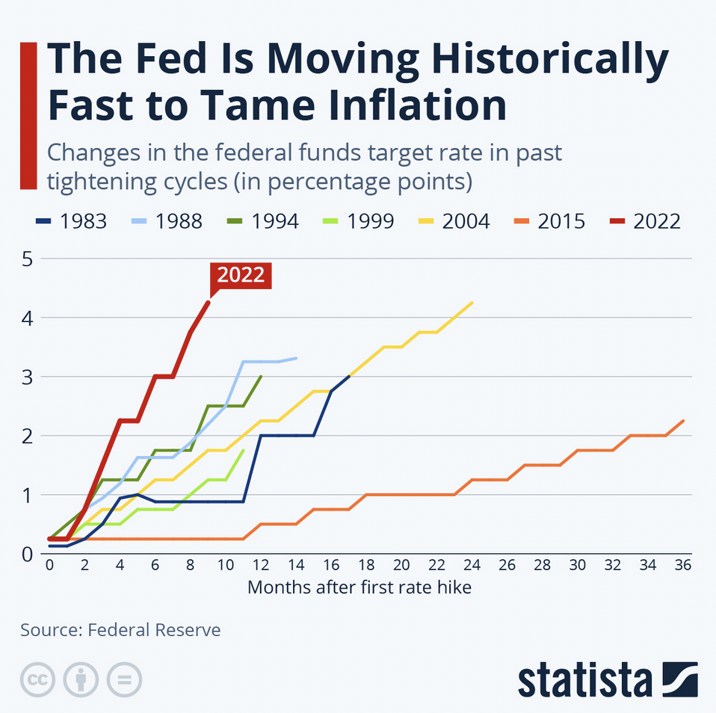
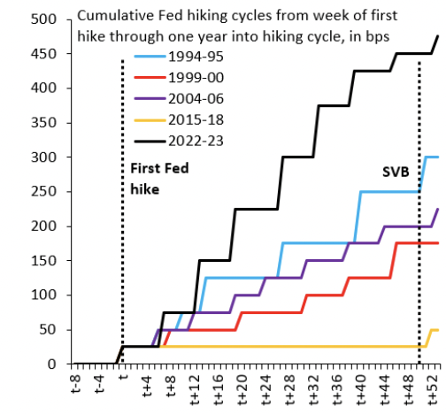
The most aggressive monetary policy response in Federal Reserve history;
But why?
Side effects: collapse of bond values; failure of SVB

Slide 25
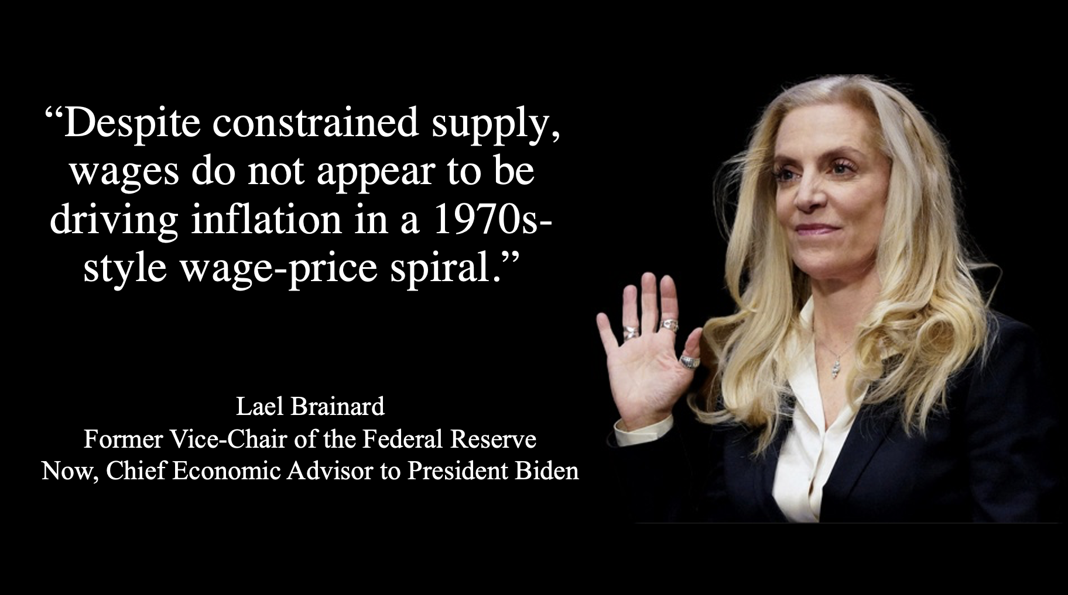

Slide 26
Central bank view: low and stable inflation is best suited for economic growth. So, how destabilizing is inflation?
Greatest fear is the de-anchoring of inflation expectations and the emergence of a wage-price spiral; i) several surveys shows they are not unanchored; and ii)
“Economists and economic policymakers believe that households’ and firms’ expectations of future inflation are a key determinant of actual inflation. A review of the relevant theoretical and empirical literature suggests that this belief rests on extremely shaky foundations, and a case is made that adhering to it uncritically could easily lead to serious policy errors.”
Jeremy B. Rudd (Federal Reserve Board), Review of Keynesian Economics, 10 (1), Spring, pp. 25-45.

Slide 27
Central bankers were right last year when they claimed inflation was going to be temporary;
So why raise interest rates?
Was monetary austerity for nothing?

Slide 28
Given the above analysis, let us now answer the question posed at the very beginning of this presentation:
When are central banking & interest rates a hindrance to reindustrialization? The answer should now be rather evident
I am not a fan of using monetary policy as a counter-cyclical policy
Monetary policy: long lags; blunt instrument: wait and see

Slide 29
Given the above discussion: are central banks impotent?
  Adair Turner: “Yes”
  “The impotence of central bank monetary policy has been increasingly obvious since the global financial crisis of 2008. In the aftermath of that shock, central banks across the world cut interest rates close to or even below zero, but the impact on investment or consumption was limited because overleveraged companies and households were unwilling to borrow even at rock bottom rates.”

Slide 30
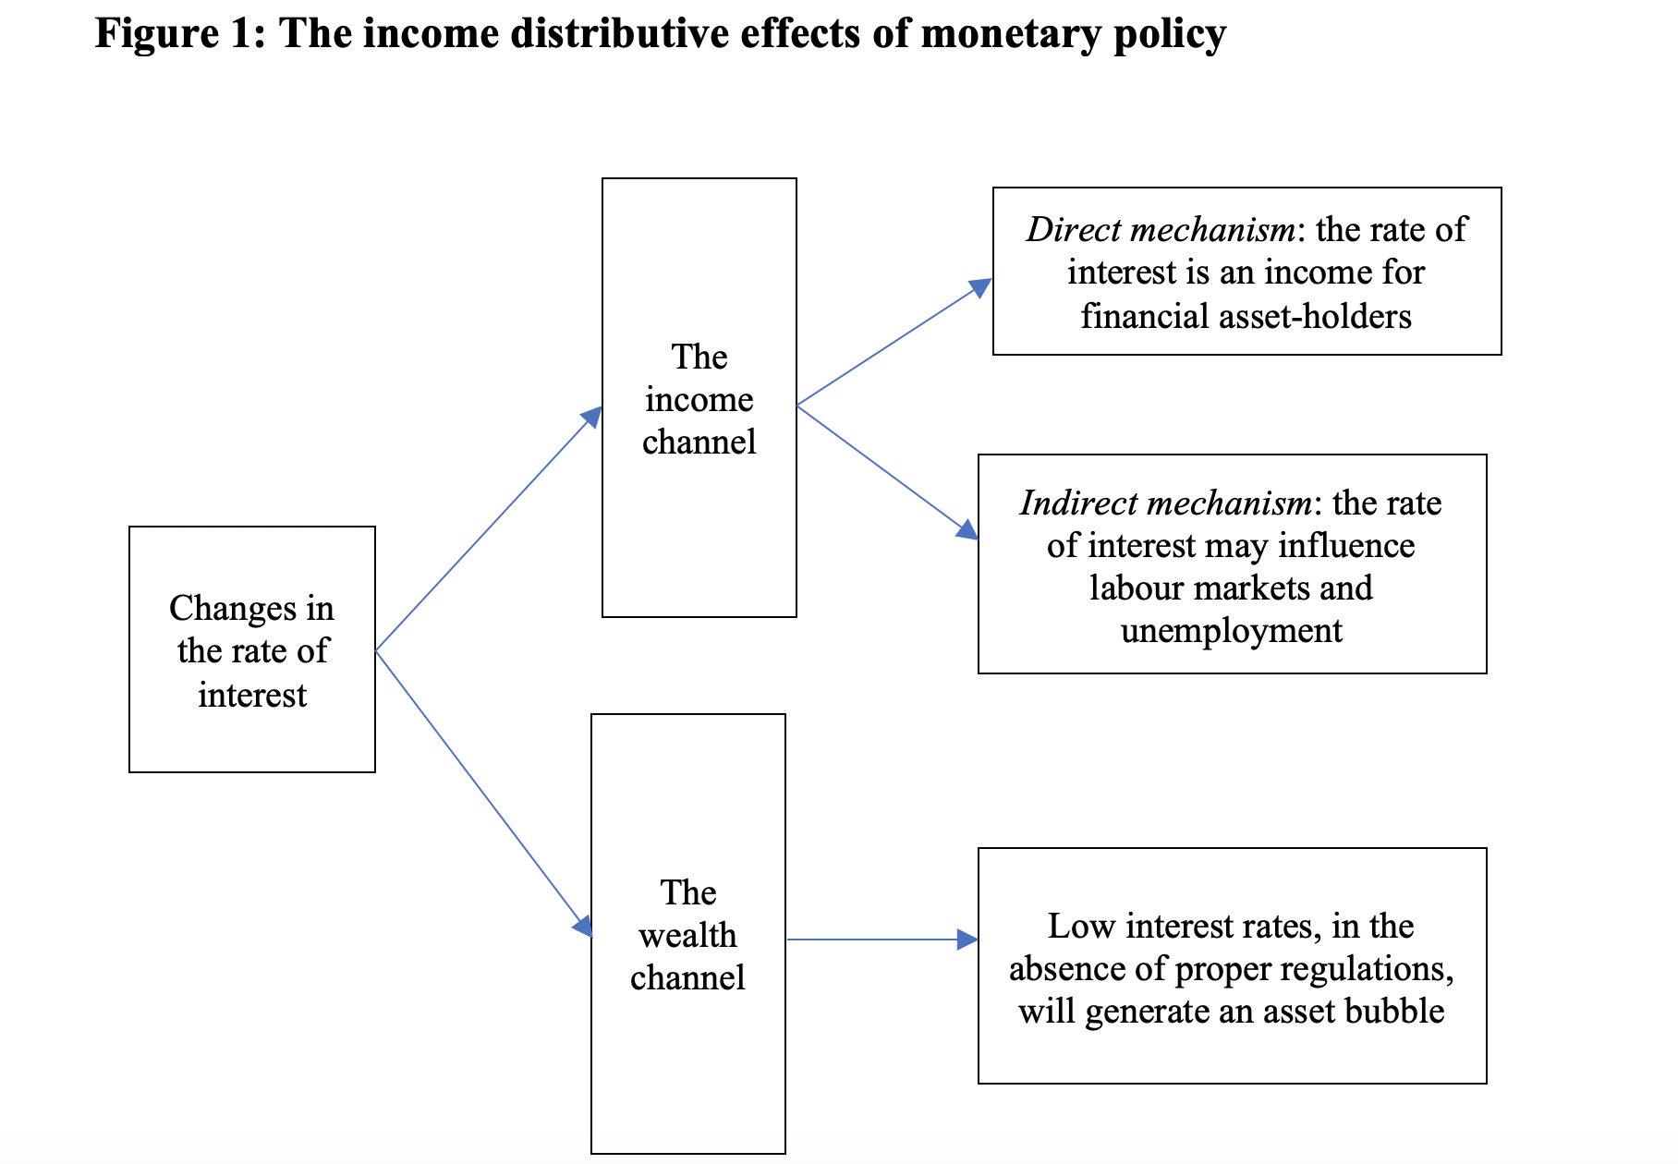
Monetary policy is about income distribution: not just a cost but also a revenue

