Slide 1

DECONSTRUCTING MONETARY POLICY undermining the mainstream approach of fine tuning
April 28, 2022
5th Nordic Post-Keynesian Conference
Aalborg, Denmark
LOUIS-PHILIPPE ROCHON
@LROCHON
Full Professor, Laurentian University
Founding Editor, Review of Keynesian Economics
Consulting Editor, Advances in Economics Education
Editor-in-Chief, Review of Political Economy

Slide 2

ALAIN PARGUEZ
1940-2022
“Vive la révolution”

Slide 3
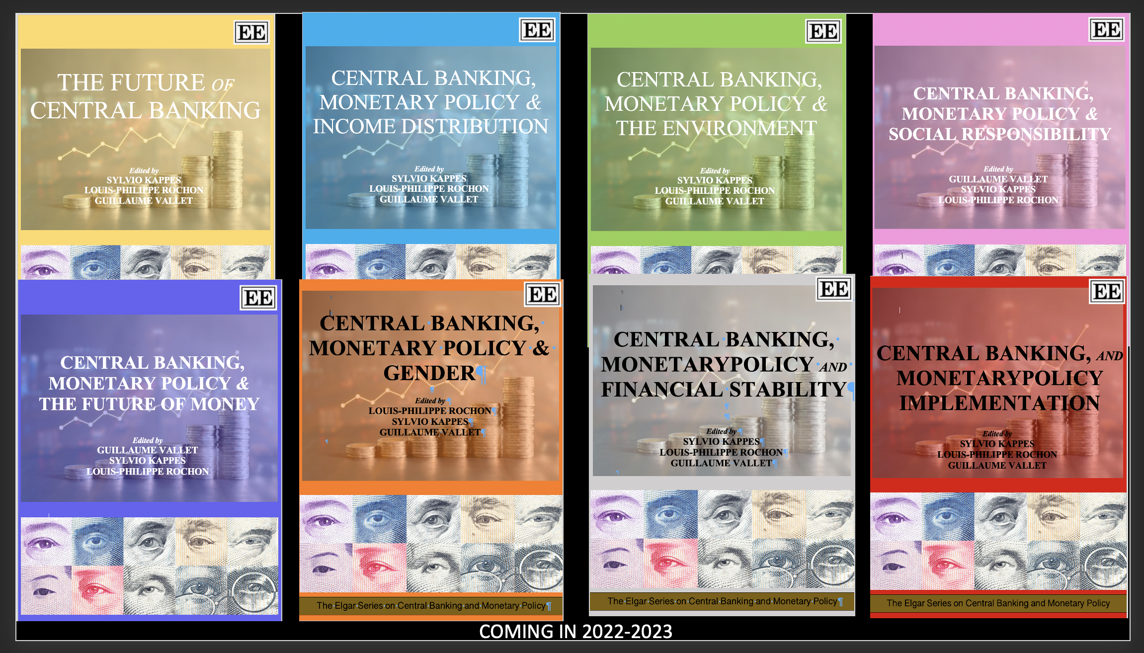

Slide 4
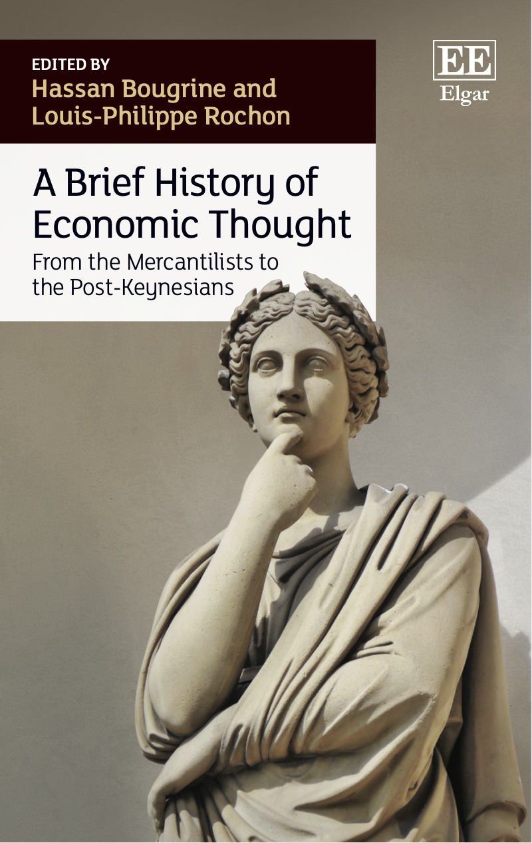
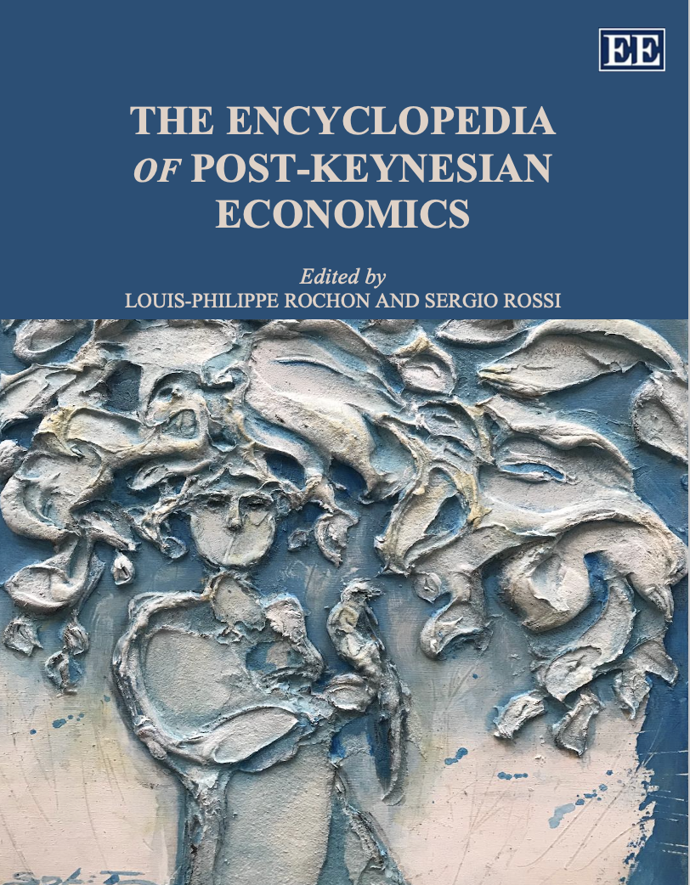

Slide 5
MONETARY POLICY
This presentation is part of my forthcoming book, “Monetary Policy”
Chapter One
“Deconstructing Monetary Policy: the mainstream view”
Chapter Two
“Reconstructing Monetary Policy: the post-Keynesian view”

Slide 6
INTRODUCTION
Interesting times to be looking at central banks and their role in the fight against inflation;
The NC model is still the dominant model; the “the bread and butter of central bank researchers” (Lavoie, 2014, p. 10);
Initially, I think, PK were happy to see what they perceived to be endogenous money in NC models; this was a mistake, as it is now being recognized;
Many criticism of IT and New Consensus models: but all rather general in nature;
First attempt at a step by step approach to deconstruct the model.

Slide 7
LEADING UP TO CURRENT INFLATION TARGETING REGIME
End of Bretton Woods, inflation crises in 1973 and 1979 (oil shock)
The collapse of the Keynesian model
Rise (and collapse) of monetarism: rules vs discretion debate: the lost decade; Friedman (1962, p. 239) favoured rules because of deep mistrust of central bankers: experts; did not approve of “wide discretion to independent experts”.
Followed by the abandonment of monetary aggregate targeting:
  Failure of monetary aggregate targeting: lost control of the money supply: money’s endogeneity
  “We didn't abandon the monetary aggregates, they abandoned us” (Gerald Bouey)
  “A decision to base policy on measures of money presupposes that we can locate money. And that has become an increasingly dubious proposition” (Alan Greenspan)
  “That classic relationship between monetary aggregates and economic growth and the size of the economy, it just no longer holds… so something we have to unlearn, I guess” (Jerome Powell)
Adoption of inflation targeting in early 1990s (New Zealand in 1990; Canada 1991): target remains the same but the instrument changes
Inflation is seen as an “evil” (Johnson, 2016), and low inflation as a public good: “Do central banks serve the people?”

Slide 8
But what I want to argue today:
“It is a long and uncertain chain of events from an adjustment in the interest rate controlled by the central bank to a desired change in the rate of inflation” (Arestis and Sawyer, 2003, p. 5).
There may be, as Keynes tells us, “several slips between the cup and the lip.”
Once we deconstruct the model, nothing is left:
  general monetary policy impotence

Slide 9
INFLATION TARGETING
New Consensus (PK expression) or Neo-Wickellian or New Keynesian (mainstream expression) Models: Romer 2000; Woodford 2003; it is the “new international monetary system” (Rose, 2007).
Long-run neutrality of money; but short run endogenous money???
Inflation is still seen as related to money/aggregate demand/monetary policy: money is everywhere a monetary policy phenomenon: which explains monetary policy dominance’ or according to Gordon (1997, p. 17): “in the long run inflation is always and everywhere an excess nominal
GDP phenomenon.”
Central Bank Independence (at least in theory): ECB
Natural rates of: interest, unemployment, growth: natural rate of inflation !
Anchoring agents’ inflationary expectations directly around a low and stable level (but see Rudd, 2022, in ROKE)

Slide 10
INFLATION TARGETING
“Economists and economic policymakers believe that households’ and firms’ expectations of future inflation are a key determinant of actual inflation. A review of the relevant theoretical and empirical literature suggests that this belief rests on extremely shaky foundations, and a case is made that adhering to it uncritically could easily lead to serious policy errors.” (Rudd, 2022)

Slide 11
NEW CONSENSUS MODEL (or ‘modern view’)
Taylor (2000, p. 90): “At the practical level, a common view of macroeconomics is now pervasive in policy-research projects at universities and central banks around the world. . . . It differs from past views, and it explains the growth and fluctuations of the modern economy; it can thus be said to represent a modern view of macroeconomics.”
Simple, elegant, 3-equation model:
  1) IS curve: inverse relationship between real or nominal rate and output via C and I (interest-sensitive components of aggregate demand)
  2) Phillips curve: inverse relationship between inflation and unemployment
  3) Reaction function with the natural rate of interest (Taylor Rule)
In theory, it does not matter whether we have an interest rate or money supply rule: Taylor (1993, p.196): “The rules are responsive, calling for changes in the money supply, the monetary base, or the short-term interest rate in response to changes of the price level or real income”. See Ben Friedman story.
With an inflation target or a natural rate of inflation: when inflation is above target, then surely real rate must be below natural rate
As Lavoie (2006, p. 167) has correctly observed, it is merely “old wine in a new bottle”.

Slide 12
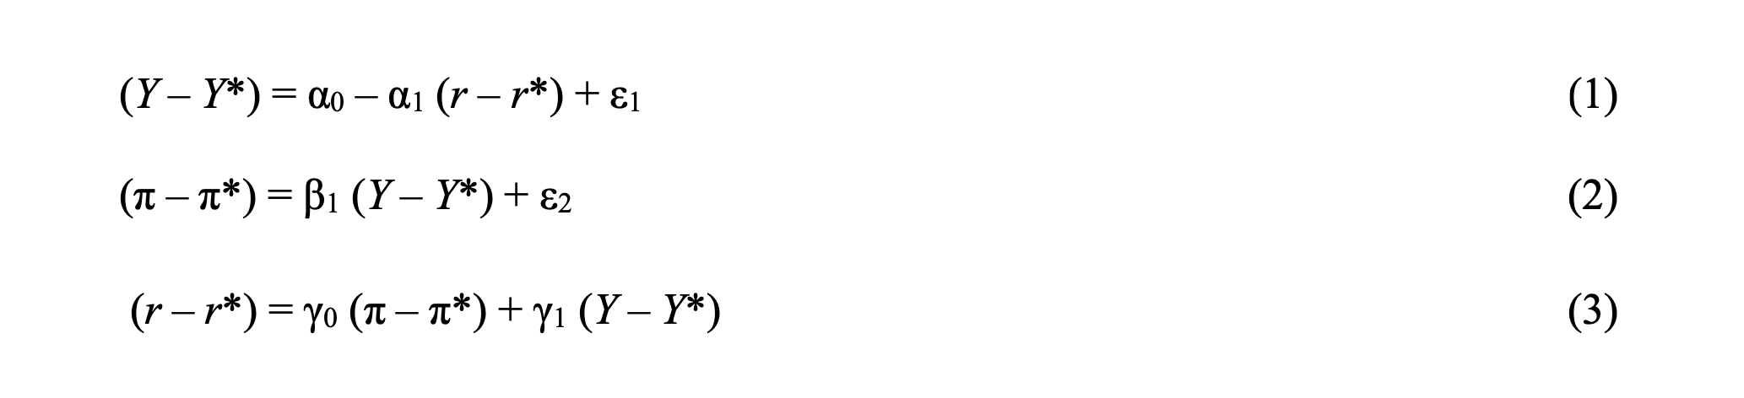
NEW CONSENSUS MODEL
A basic version of the model (you can add lagged variables, intertemporal optimization of utility
functions, etc). Similar transmission mechanisms in HANK, RANK or TANK models: effects of changes in interest rates on consumption (direct effect) and labour markets Indirect effects) via intertemporal substitution effects (Kaplan, Moll and Violante, 2018)

Slide 13
Let’s explore the model …..

Slide 14
Deconstructing the model
1) Inflation targeting as a policy
2) IS curve
3) Phillips curve
4) Natural rate of interest
5) Fine tuning
6) Demand-side inflation
7) CBI
8) Monetary Policy Dominance

Slide 15
1. INFLATION TARGETING
Today’s system is just one more attempt to target or control the rate of inflation (why this obsession with inflation? Low inflation is seen as a common good)
crisis of the gold standard after World War I. Irving Fisher proposed a "compensated dollar" system in which the gold content in paper money would vary with the price of goods in terms of gold, so that the price level in terms of paper money would stay fixed. Fisher's proposal was a first attempt to target prices while retaining the automatic functioning of the gold standard.

Slide 16
1. INFLATION TARGETING
2% or corridor system; New Zealand, 1990; Canada, 1991; never had a specific Inflation target: thought 2% was low and stable: maximum employment;
Acts as a centre of gravitation (equilibrium)
But why 2%?: reading up on the history of IT reveals very little;
As Benjamin Friedman claimed recently, “there is the arbitrariness surrounding the current 2 percent target. In retrospect, the paucity of serious empirical research underlying the identification of the 2 percent norm, now quite some time back is a professional embarrassment” Friedman (2018, p. 187).
Emmanuel Carré (2014): “economic theories have played a limited role in the creation of inflation targeting.”

Slide 17
1. INFLATION TARGETING
Has IT been successful?
Ball and Sheridan (2004) conclude that if overall targeters reduced inflation rates by more than the non-targeter, this was only because inflation rates were higher in IT countries than in non-IT countries initially:
“On average, there is no evidence that inflation targeting improves performance as measured by the behavior of inflation, output or interest rates” (Ball and Sheridan, 2003, p. 2; see also Roger and Stone, 2005; Mishkin and Scmidt-Hebbel, 2001).
Borio (2017, p. 2) recently mused, “[m]ight we have overestimated our ability to control inflation, or at least what it would take to do so?”

Slide 18
2. THE IS CURVE
Interest Rate
“the interest rate rather than the money supply is the key instrument that should be adjusted” (Taylor 1999, p. 47)
1) Does this change anything?
2) Is it really endogenous money?
MP curve
IS curve
Output

Slide 19
2. THE IS CURVE
Mainstream theory expects the IS curve to be elastic: for the monetary transmission mechanism to work, you need changes in interest rates to have a predictable, or sizeable impact on output, in a first instance;
“The more sensitive the response, the more potent is monetary policy” (Hall, 1977): effectiveness of monetary policy.
Indeed, the stimulus of lower interest rates on investment is one
of the principal channels of monetary influence in virtually all macroeconomic theories, including in some versions of PK economics;

Slide 20
2. THE IS CURVE
This is of course an empirical question. But there are empirical indications that this much-coveted IS relationship is problematic. For instance, according to Cynamon, Fazzari and Setterfield (2013, p. 13),
  “The transmission mechanism from monetary policy to aggregate spending in new consensus models relies on the interest sensitivity of consumption. It is difficult, however, to find empirical evidence that households do indeed raise or lower consumption by a significant amount when interest rates change. Some authors have generalized the link to include business investments (see Fazzari, Ferri, and Greenberg, 2010 and the references provided therein) but a robust interest elasticity of investment has also been difficult to demonstrate empirically.”
Sharpe and Suarez (2015, p. 1; reconfirmed in 2021)
  “A large body of empirical research offers mixed evidence, at best, for substantial interest-rate effects on investment. [our research] find that most firms claim their investment plans to be quite insensitive to decreases in interest rates, and only somewhat more responsive to interest rate increases.”

Slide 21
2. THE IS CURVE
Krugman (2018) reaches a similar conclusion:
  “It’s a dirty little secret of monetary analysis that changes in interest rates affect the economy mainly through their effect on the housing market and the international value of the dollar (which in turn affects the competitiveness of U.S. goods on world markets). Any direct effect on business investment is so small that it’s hard even to see it in the data. What drives such investment is, instead, perceptions about market demand.”
Kopp, Leigh, Mursula and Tambunlertchai (IMF, 2019, p. 4) reach the same conclusion. According to the authors, there “appears to be little unexplained component of business investment beyond the expected demand effect. Other factors, such as reductions in the cost of capital, thus appear to have played a relatively minor role.”
An old truth: Robert Hall (1977) stated the “the evidence is disappointingly weak”

Slide 22
2. THE IS CURVE
How about HANK, RANK and TANK models
Still researching. So far:
  “The strong response of aggregate consumption to movements in real rates that accounts for the large direct effects in RANK is questionable in light of empirical evidence. Macroeconometric analysis of aggregate time-series data finds a small sensitivity of consumption to changes in the interest rate after controlling for income.” (Kaplan, Moll, and Violante, 2018, p. 698)
In HANK models
  “the direct effects of interest rate shocks in our HANK model are always small while the indirect effects can be substantial …. households are highly sensitive to labor income shocks but are not responsive to interest rate changes.” (Kaplan, Moll, and Violante, 2018, p. 699)

Slide 23
3. THE PHILLIPS CURVE
Inflation
Unemployment

Slide 24
3. THE PHILLIPS CURVE
Wage inflation
There is a horizontal range where inflation does not vary much with capacity utilization (Hein, 2002; Lavoie, 2014)
Rates of capacity utilization

Slide 25
3. THE PHILLIPS CURVE
Bullard (2019): “U.S. monetary policymakers and financial market participants have long relied on the Phillips curve—the correlation between labor market outcomes and inflation—to guide monetary policy.”
NBER (2019), “the relationship between inflation and the unemployment rate is a key input to the design of monetary policy.”
BUT …
Claudio Borio, has recently argued that “the response of inflation to a measure of labour market slack has tended to decline and become statistically indistinguishable from zero. In other words, inflation no longer appears to be sufficiently responsive to tightness in labour markets” (Borio, 2017, p. 2).
Borio (2017, p. 2): “the response of inflation to a measure of labour market slack has tended to decline and become statistically indistinguishable from zero. In other words, inflation no longer appears to be sufficiently responsive to tightness in labour markets”
Arestis and Sawyer (2003, p. 5): “It is a long and uncertain chain of events from an adjustment in the interest rate controlled by the central bank to a desired change in the rate of inflation.”
Gordon (1989): “was there ever a Phillips curve”?

Slide 26
3. THE PHILLIPS CURVE
“Various inflation drivers have been shaping the inflation process in ways that at times have been difficult to fully understand. The heightened uncertainty has natur15ally carried over to inflation forecasting” (BIS, 2015, p. 74)
“The slope of the Phillips curve itself has been getting flatter, ever since the1980s, and is now quite small. … there is no well-defined natural rate of unemployment, either statistically or conceptually.” (Solow, 2018, p.423).
“The slope of the short-run inflation– unemployment relationship has flattened” (Gordon, 2018, p. 427).
“The slope of the Phillips curve—a measure of the responsiveness of inflation to a decline in labor market slack—has diminished very significantly since the 1960s. In other words, the Phillips curve appears to have become quite flat.” (Janet Yellen, 2019)

Slide 27
3. THE PHILLIPS CURVE
A labour specialist at the US Bureau of Labor Statistics, Politano (2021, online), has concluded that "Over the last 20 years, the Phillips curve relationship has nearly completely broken down in the United States".
Mary C. Daly, President of the Federal Reserve Board of San Francisco (see Daly, 2019), who argues that "As for the Phillips curve… most arguments today center around whether it’s dead or just gravely ill. Either way, the relationship between unemployment and inflation has become very difficult to spot."

Slide 28
3. THE PHILLIPS CURVE
Despite this, many at the federal Reserve “assume” the existence of the Phillips Curve:
Jerome Powell (2018): “the Phillips curve continues to be meaningful for monetary policy”. It was simply “hibernating”;
Dennis Lockhart (president of the Federal Reserve Bank of Atlanta):
  “I think a policymaker has to act on the view that the basic relationship in the Phillips curve between inflation and [un]employment will assert itself in a reasonable period of time as the economy tightens up, as the resource picture in the economy tightens.”

Slide 29
3. THE PHILLIPS CURVE
“All of the forgoing examples show that central bankers are not yet willing to discard the Phillips curve as a policy tool, even though the evidence for a downward sloping curve is meager” (Dorn, 2020)
“Without the PC, the whole complicated paraphernalia that underpins central bank policy suddenly looks very shaky. For this reason, the Phillips Curve will not be abandoned lightly by policy makers” (Gavin Davies, in the FT, 2017)

Slide 30
4. THE NATURAL RATE OF INTEREST
“The natural rate is the key element of the New Consensus model” Lavoie, 2014, p. 189); centre of gravitation for short-term interest rates; “pursuit of the holy grail”
May take any value, even negative (Summers)
But as Borio (2017, p. 8) explains, “the natural rate is an abstract, unobservable, model-dependent concept.”
“Although it is relatively straightforward to define the natural rate of interest, it is less straightforward to measure it.” “FRBSF, Economic Research, 2003)
Borio (2021): "r* is very imprecisely estimated and contains little information beyond that provided by other variables ... As a result, r* is not really needed when setting the policy stance. ... [Moreover] r* has the potential of leading policy astray."

Slide 31
5. FINE TUNING
Roots: Walter Heller (economic advisor to Kennedy)
Rules vs discretion debate
Joan Robinson recognized this problem as early as 1943: "The regulating effect of changes in the rate of interest was at best very weak" (see 1943, p. 26), and again in 1952, where she describes as a 'false scent' the use of counter-cyclical monetary policy, and rejects: "the conception of an economy which is automatically held on a path of steady development by the mechanism of the rate of interest ... But it is by no means easy to see how the monetary mechanism is supposed to ensure how that the rate of interest actually assumes its full employment value. ... The automatic corrective action of the rate of interest is condemned by its very nature to be always too little and too late" (see Robinson, 1952, pp. 73-74).

Slide 32
5. FINE TUNING
So the costs of fine tuning can be large: “Because reaction functions rely on fine-tuning the economy as needed, the central bank’s policy obsession with inflation often translates into repeated increases in the rate of interest until the economy finally deflates (or collapses) in the misguided pursuit of a ‘soft landing’” (Rochon and Setterfield, 2008, p. 15).
What I called elsewhere, the pursuit of the Holy Grail.
The same conclusion was reached by Lavoie (2014, p. 235), “inflation control can be achieved only at the cost of large losses in economic activity.”

Slide 33
6. DEMAND-SIDE INFLATION
The nature of inflation
  Monetary policy would only theoretically work if inflation was the result of demand-side issues;
  But even if demand is at the root of inflation, then given the arguments so far, would monetary policy work?
  BUT what is inflation is the result of supply-side problems: conflict over the size of the distributive pie, or bottle necks as it seems to be the case now in 2022?
  What then: how can raising rates solve bottlenecks?

Slide 34
7. CENTRAL BANK INDEPENDENCE
“The emergence of a new consensus about monetary policy … highlighted, among other things, the importance of central bank independence” (Berger and Kißmer, 2013)
Necessary for the credibility of central banks (”anti-inflation credibility”) and central bankers; independence in theory; not so much in practice;
Central banks have engaged in credit policy (the extension of discount
window lending to firms and markets other than commercial banks and the money market on the basis of risky collateral), bailouts of non bank financial institutions, and quantitative easing involving the purchase of risky mortgage backed securities and long-term Treasury securities.
CBI has been de facto largely questioned in practice by the actions of the central banks themselves: with the recent two crises, central banks have been mobilized to an extent rarely seen before : “Whatever it takes” (Draghi, July 26, 2012): To save the Euro Zone as a political entity;
“These actions have seriously threatened central bank independence and its crucial corollary credibility for low inflation” (Bordo, 2010, p. 29).
“Central bank independence can be harmful if it is based on a flawed policy
doctrine or a structurally flawed institution” (Bordo, 2010, p. 33)
Central banks are increasingly working with Treasuries: the end of the myth of CBI.

Slide 35
7. CENTRAL BANK INDEPENDENCE
But also, central bank independence challenges the specific relation between a people and its representatives (Rochon and Vallet, 2022: Central Bank Independence in an Age of Democratic Values); central banks at the intersection of social responsibility;
Rochon and Seccareccia (2022: “A Primer On Monetary Policy and Income Distribution: A Heterodox Perspective “): monetary policy is best seen as income distributive with long-lasting effects: an incomes policy? Monetary policy leads to winners and losers;

Slide 36
7. CENTRAL BANK INDEPENDENCE
Friedman was critical of the idea than “in a democracy to have so much power concentrated in a body free from any kind of direct, effective political control” (1962, p. 227). “Money”, he stated in the opening sentence, “was too important to be left to central bankers.” We should be, he added, “fundamentally fearful of concentrated power.”
For Keynes: not opposed to experts in central banks, but he “maintained that CBI must guarantee that authorities operate in the interests of society as a whole, rather than those of private or public group.” (Panico and Piccioni, 2018, p. 173)

Slide 37
7. CENTRAL BANK INDEPENDENCE
But do independent central banks perform better? Empirical question.
“The notion than an independent central bank reduces a country’s inflation has been embraced by academics, central bankers, and politicians all over the world. This is somehow puzzling, giving the ambiguity reported in empirical studies … central bank independence has no clear effect on inflation” (Baumann, Rossi, and Schomaker, 2021).
More (albeit older) support: Cargill (1995); Campillo and Miron (1997);
But independent from whom?
  “Where central banks are ‘independent’ of the executive branch of government, they tend to be dependent on the financial sector for political support, and therefore tend to make policy with ‘finance coloured’ glasses “ (Epstein, 2015)
Central banking at the intersection of society: Veblen and vested interests

Slide 38
8. MONETARY POLICY DOMINANCE
If you google 'monetary policy dominance', almost/virtually nothing comes up, whereas there is a considerable number of links for 'fiscal policy dominance’.;
fiscal policy is neutralized for the benefit of the alleged monetary policy;
What are we trying to fix, and can fiscal policy do it as well?

Slide 39
CONCLUSION
What’s left of mainstream monetary policy model? As Borio (2021. p. 3) observes, "inflation has proved rather insensitive to monetary policy easing", in which case, then what?
Impotence? Mainstream: this applies to low interest rates environment;
Or “The General Ineffectiveness of Monetary Policy”? in Kappes, S., L.-P. Rochon and G. Vallet (2022), The Future of Central Banking. Cheltenham: Edward Elgar.
Gavin Davies: “[w]ithout the PC, the whole complicated paraphernalia that underpins central bank policy suddenly looks very shaky. For this reason, the Phillips Curve will not be abandoned lightly by policy makers”

Slide 40
CONCLUSION
Are central banks impotent?
  Adair Turner: “Yes”
  “The impotence of central bank monetary policy has been increasingly obvious since the global financial crisis of 2008. In the aftermath of that shock, central banks across the world cut interest rates close to or even below zero, but the impact on investment or consumption was limited because overleveraged companies and households were unwilling to borrow even at rock bottom rates.”

Slide 41
CONCLUSION
Lawrence Summers (Whiter Central Banking 2019)
“What is needed are admissions of impotence, in order to spur efforts by governments to promote demand through fiscal policies and other means.”
QE is the result of this impotence: the desire to be seen as relevant despite the lower bound
But for them impotence only applies to the lower bound; for me monetary policy is blunt, asymmetric, imprecise and ineffective at low and high rates;

Slide 42
CONCLUSION
The analysis applies to some versions of post-Keynesian economics
i) why then does the profession and policy makers keep insisting on using it in determining monetary policy?;
ii) what is the purpose of monetary policy, or again, what exactly does monetary policy do? Chapter 2: Reconstructing monetary policy: the heterodox view: income distribution

Slide 43
REFERENCES
FRBSF (2003), https://www.frbsf.org/economic-research/publications/economic-letter/2003/october/the-natural-rate-of-interest/#subhead2

